Slide 1
Better Bus Route Evaluation and Prioritization
Spring 2025
Michael Mechtenberg
Program Manager

Slide 2
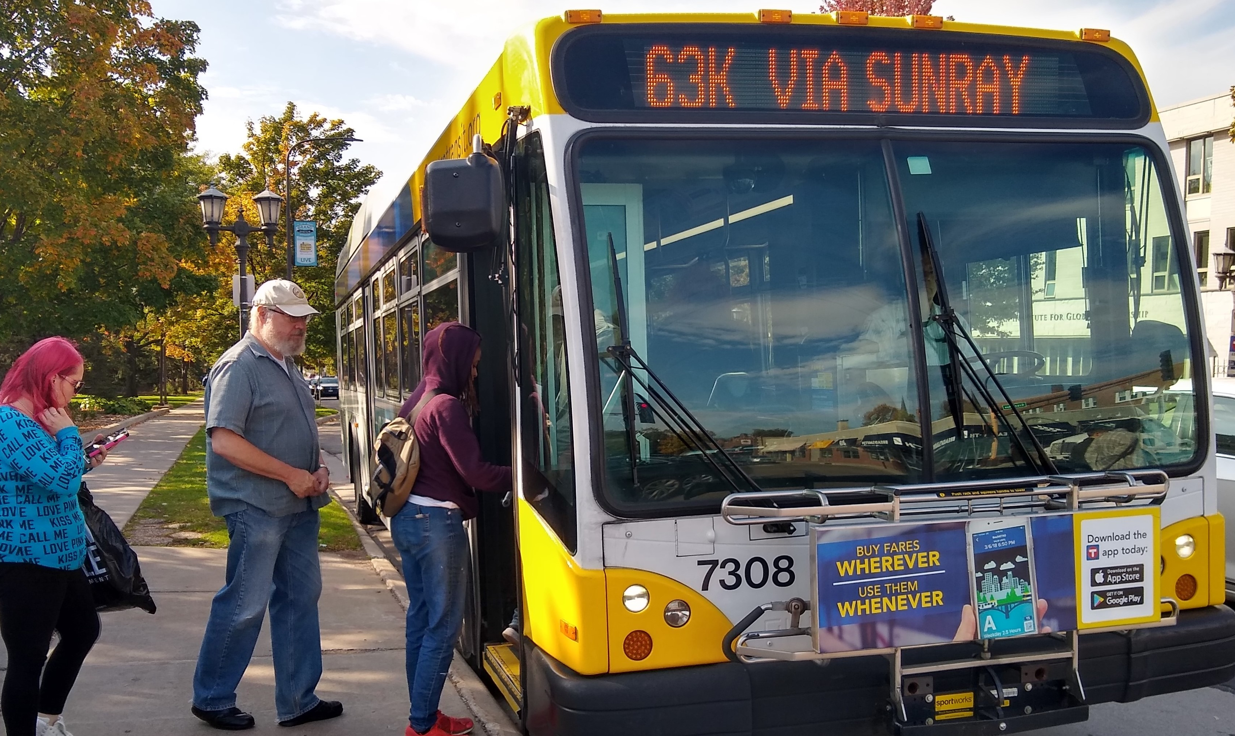
Better Bus Route Program
Initiated in 2018 to improve the speed, reliability and customer experience on local bus routes
Past projects
  Route 2 (2018)
  Route 63 (2020)
  Route 3 (2021)
  Etc.
Goal to implement two new
projects annually

Slide 3
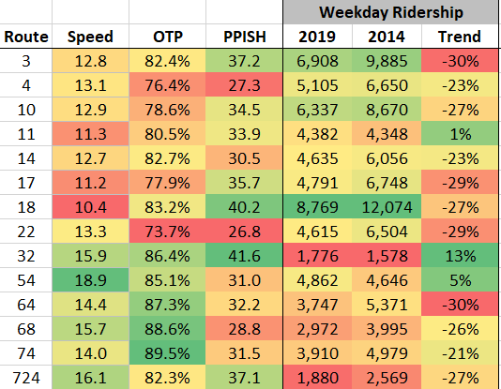
Selection Process Before 2021
Evaluation criteria primarily performance-based
Not transparent
Considered regional balance and pending opportunities
  Route 2: large shelter initiative
  Route 63: grant for service increase

Slide 4
Looking Ahead
Future arterial BRT projects identified through Network Next
Desire for a more rigorous evaluation, in part modeled off BRT
Moving beyond individual projects to a program of projects
  Benefit of city partners knowing future project
  Better internal coordination, anticipating staff workloads

Slide 5
Evaluation Approach
All Metro Transit / Met Council local and suburban local routes
  Removed routes operated by suburban providers
  Removed existing BRT routes
  Removed express routes
  61 routes included
Three selection principles = quantitative rating, grouped
Data from Feb. 2024

Slide 6
Evaluation Approach
Selection Principles
Provide consistent and competitive travel times for transit riders
Improve legibility and accessibility of routes
Promote equity of transit service in the region
Methodology
Routes are scored from 1-4 on each concept, with 4 being the highest
Next, each principle score is the average of the individual concept scores
Finally, overall score is the average of the three principles

Slide 7
Principle | Concept | Metric
Consistent and competitive travel times | Speed | Percent of time operating below 10 mph
 | Reliability | Range of commonly observed variability in travel time
 | Delay | Sum of passenger delay
Legibility and accessibility of routes | Bus stop accessibility | Sum of limited mobility index
 | Shelters | Percent qualifying stops without shelter
 | Route simplification | Number of patterns
Promote equity of transit service | BIPOC population | Percent of BIPOC people living in 10-min walkshed
 | Low-wage jobs | Number of low-wage jobs reachable by route
 | Renters | Percent of households in walkshed that rent their home
 | Low-income population | Percent of people with low incomes living in 10-min walkshed

Slide 8
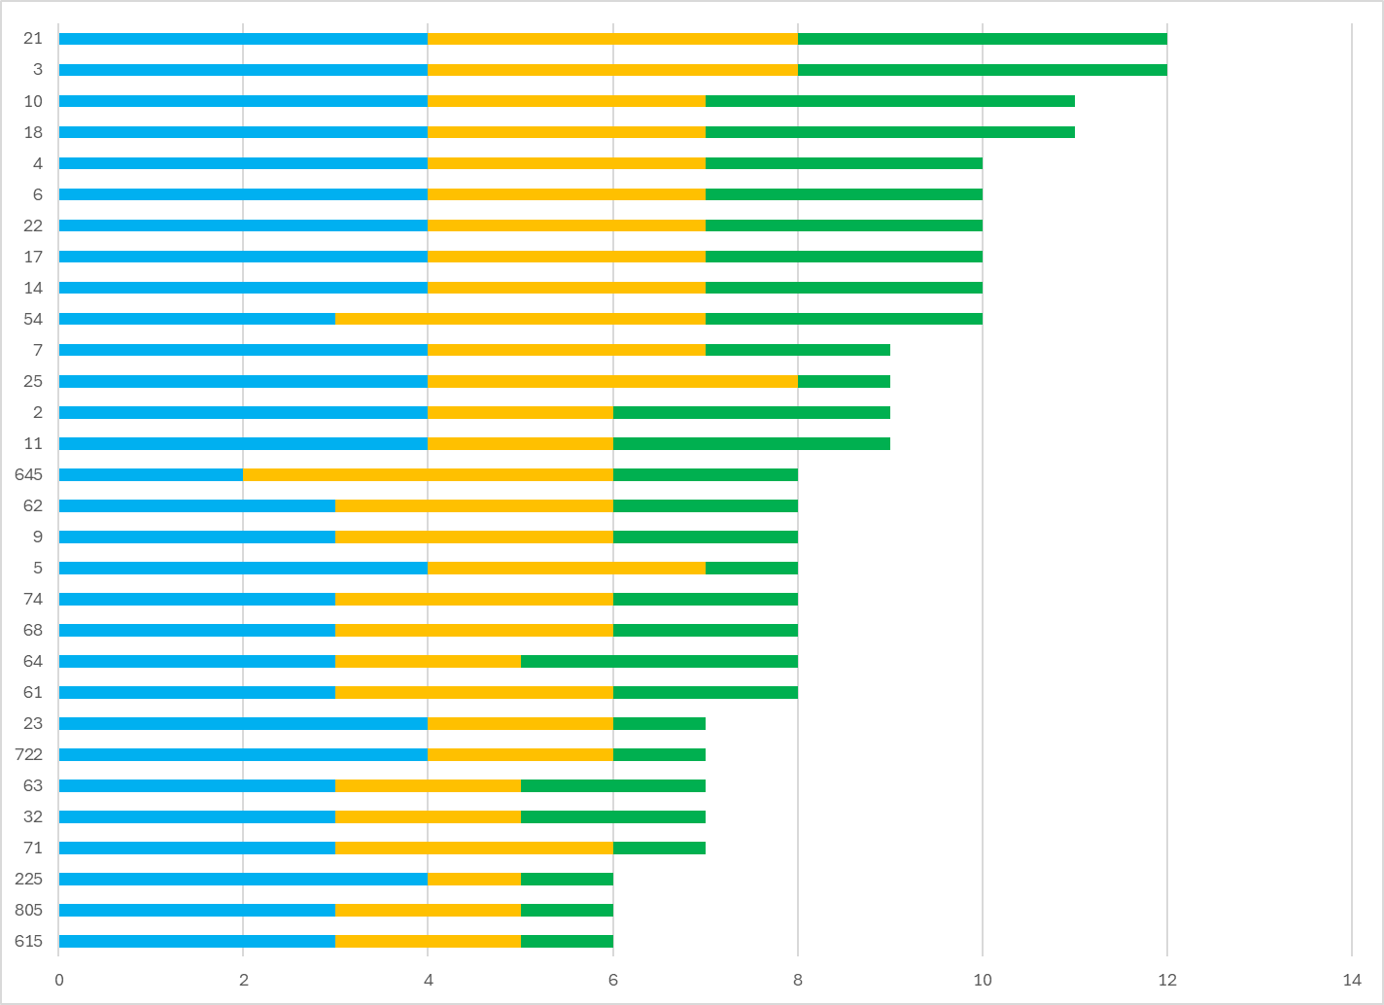

Consistent and competitive travel times
Showing top 30

Slide 9
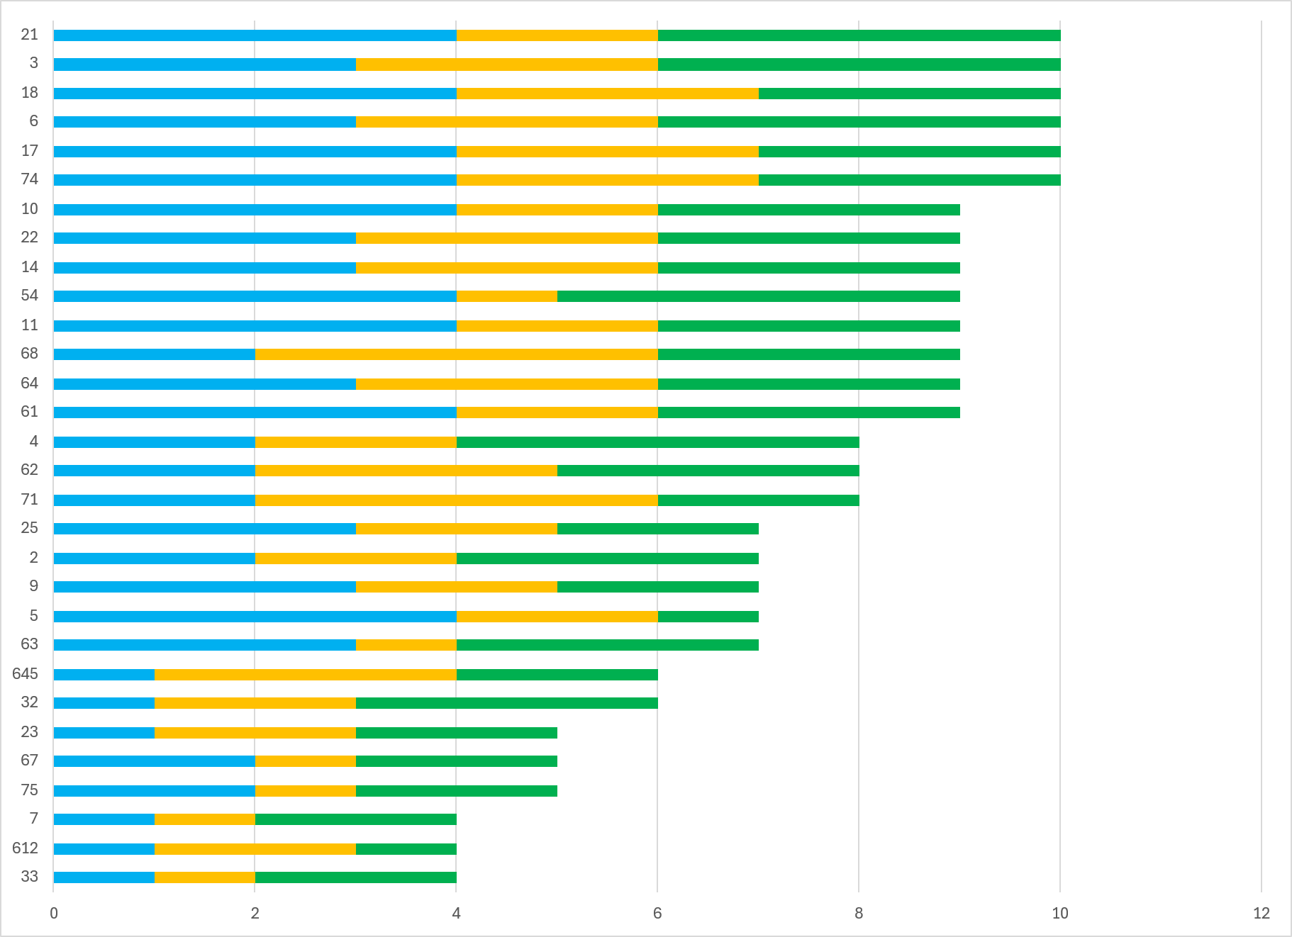

Legibility and accessibility of routes
Showing top 30

Slide 10
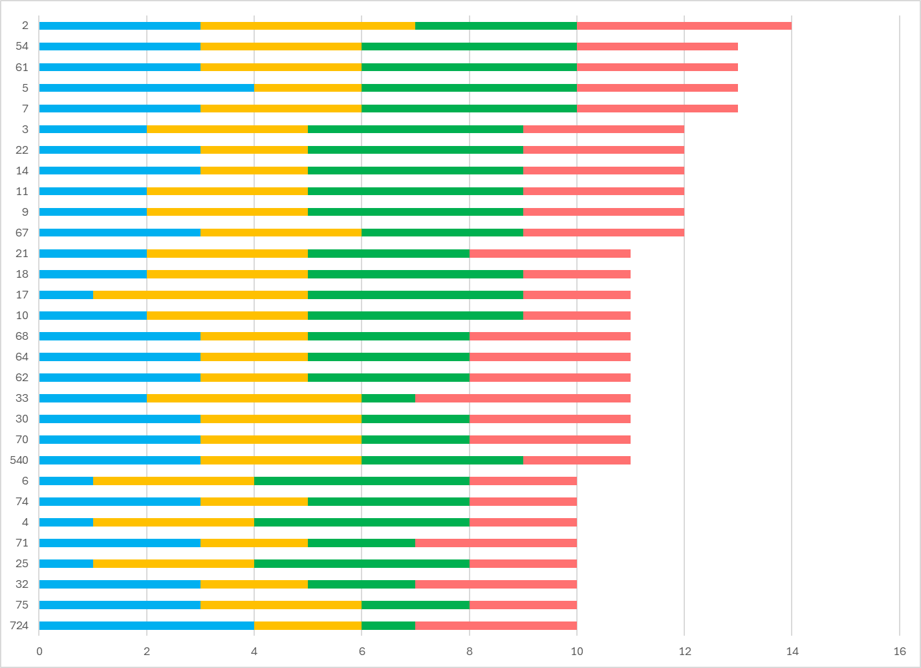
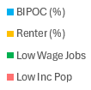
Promote equity of transit service
Showing top 30

Slide 11
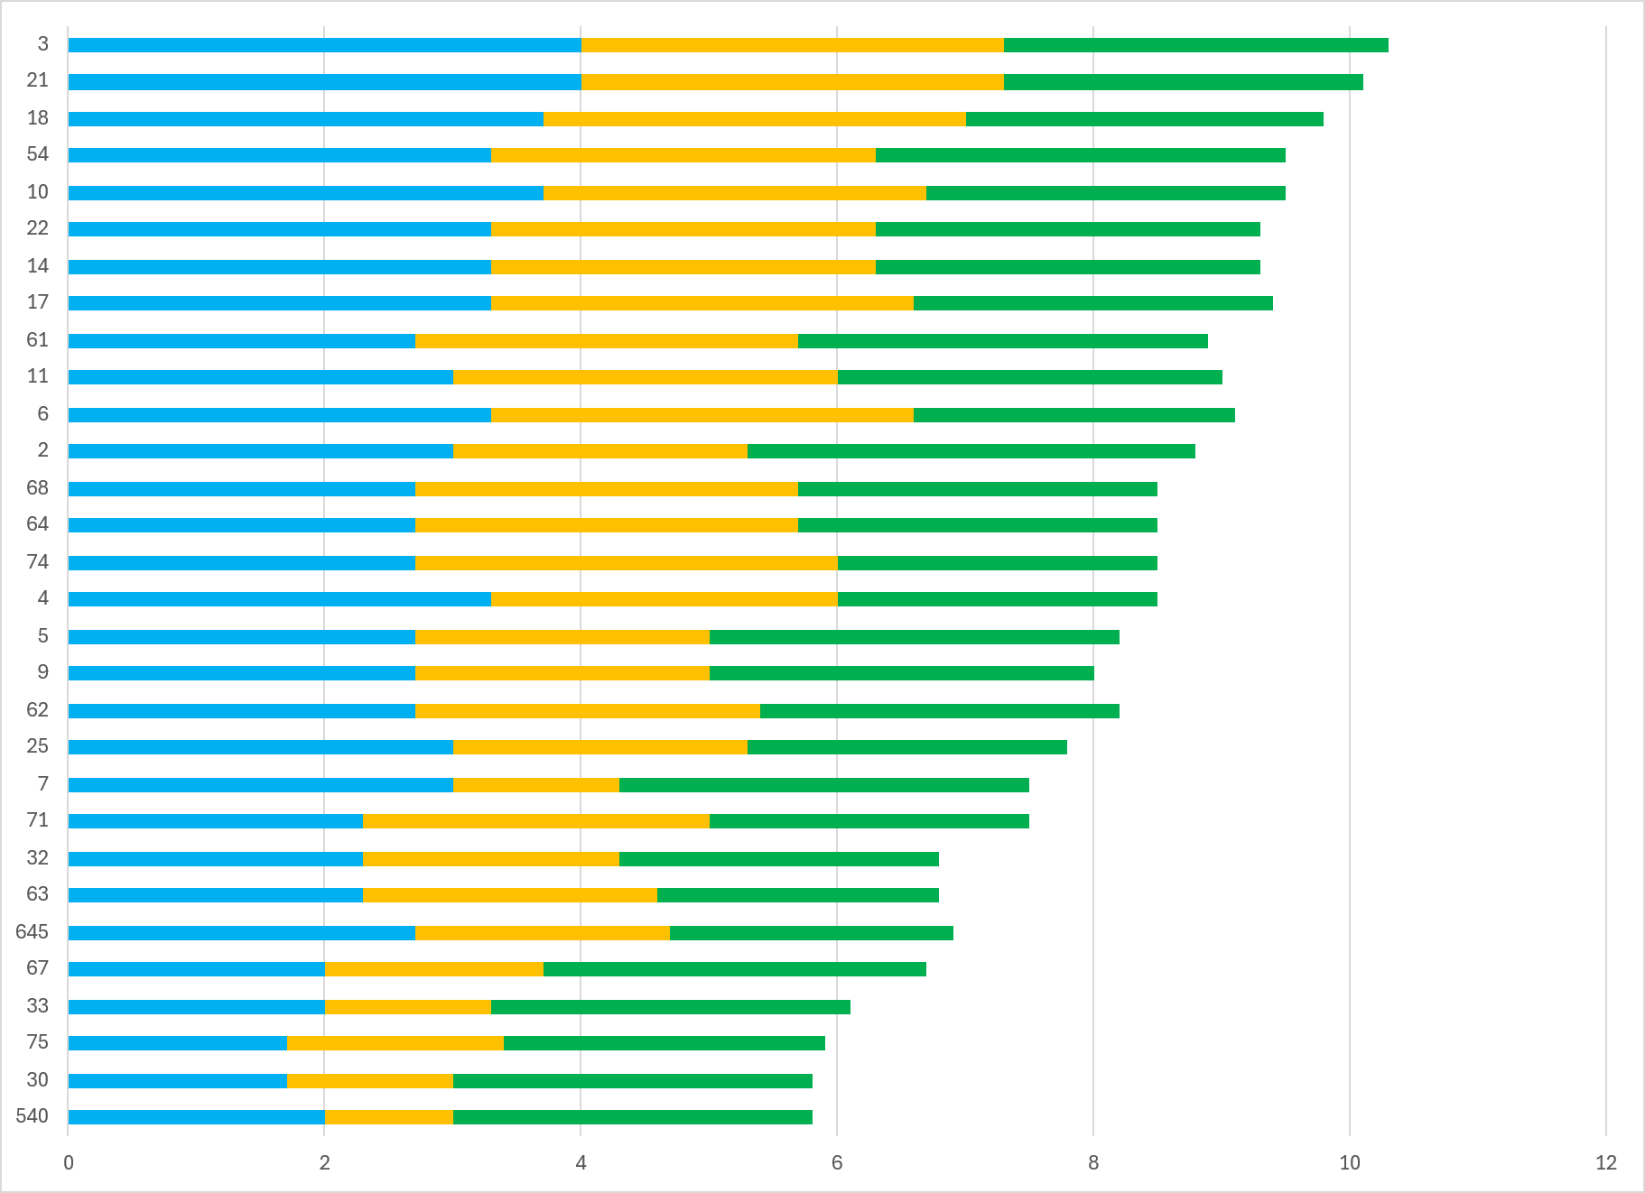

Combined Scores
Showing top 30

Slide 12
Combined Scores - Revised
Remove past BBR routes, pending arterial BRT routes

Slide 13
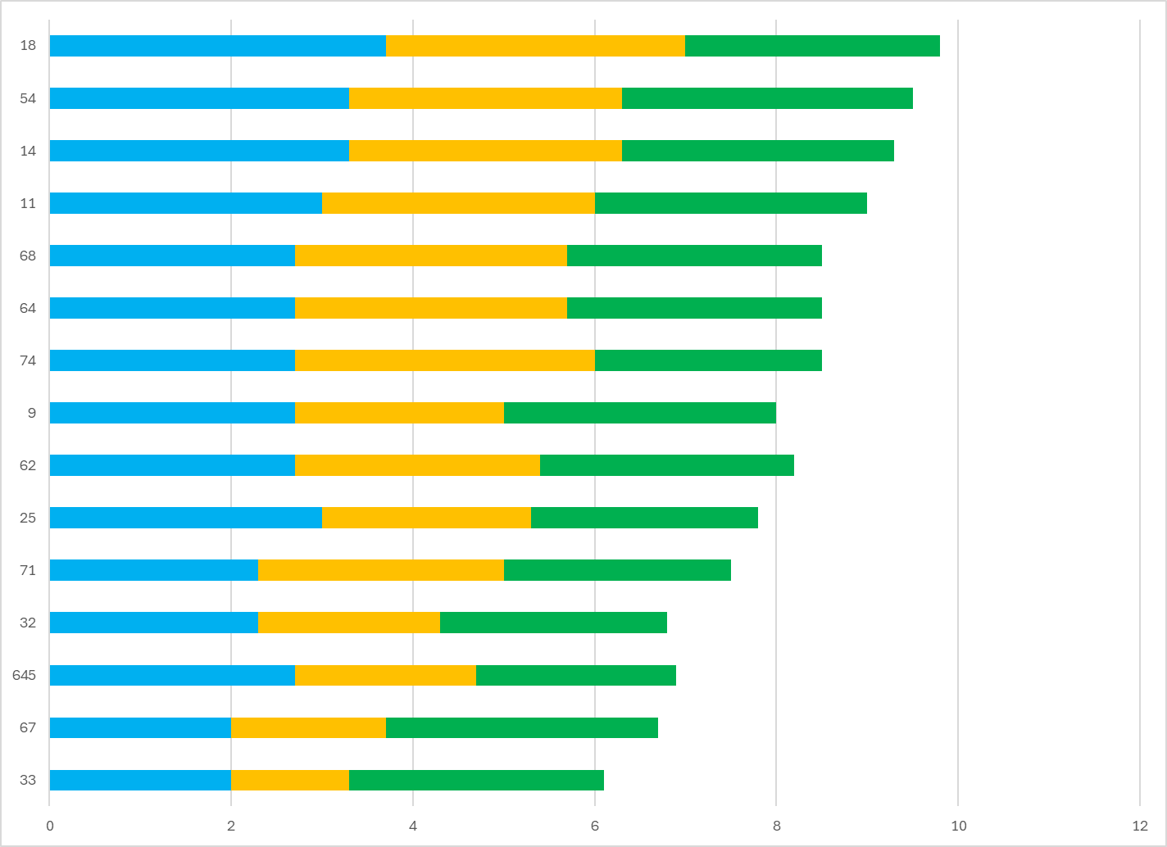
Combined Scores – Top 15

Slide 14
Prioritization Factors to Consider
Technical score
Regional balance
Anticipated improvements (Network Now)
Upcoming road and/or transit projects
Other factors

Slide 15
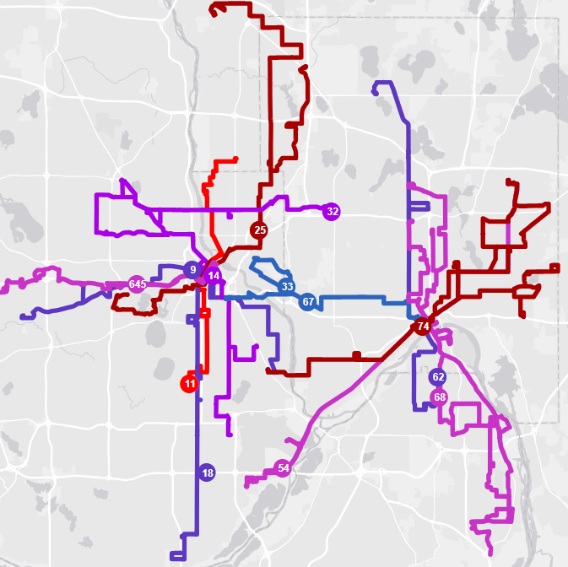
Recommendation
Year | Routes
2026 | 14, 74
2027 | 11, 32
2028-2029 | 9, 25, 67, 71
2030+ | 62, 64, 68, 645
Removed Route 18 due to fall 2025 stop consolidation, future arterial BRT (K Line)
Removed Route 54 due to pending MnDOT project, future arterial BRT (J Line)

