Slide 1
Innovative Financing for Transit Oriented Development
Meet your presenters
Lucy Galbraith, TOD, Metro Transit
Marcia Glick, City of Robbinsdale
Kathleen Aho, Baker Tilly
Bill Mague, AEON
Mikaela Huot, Baker Tilly
Maureen Michalski, Ryan Companies
Denise Butler, African Career, Education & Resource, Inc.
Leah Stockstrom, CommonBond Communities
Kent Carlson, Inland Development Partners
John Sutter, City of Crystal

Slide 2
Innovative Financing for Transit Oriented Development
Lucy Ferguson Galbraith, AICP
Director, TOD

Slide 3
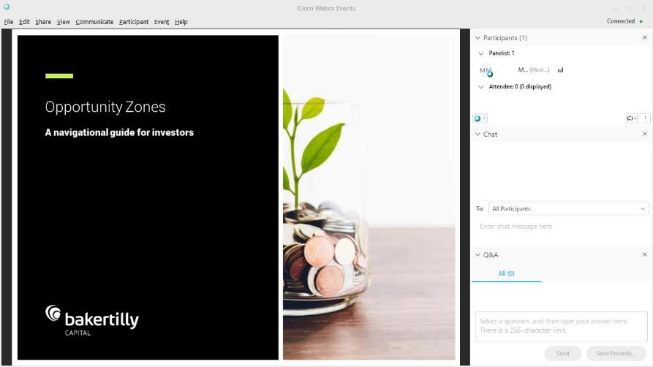
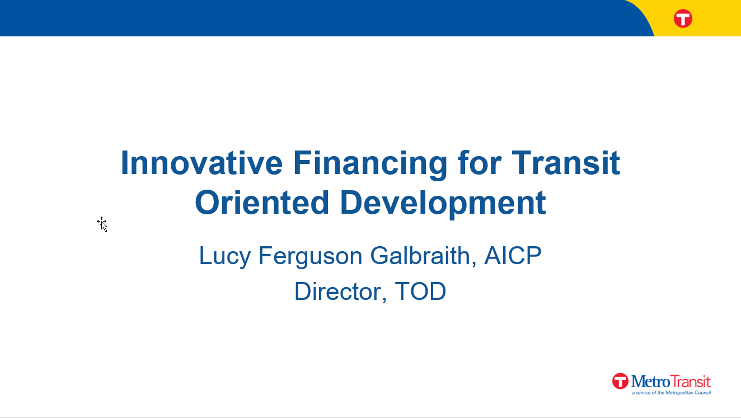
WebEx guide
Everyone is muted to avoid background noise. Use the Q&A panel if you need to communicate with the host.
Asking questions: In the Q&A panel, ask questions by choosing “All Panelists” in
“Send to” field. Type your message in the Q&A panel and hit “send.”
If disconnected:
Refer to your email and
reconnect. If audio is
disconnected, click on the
Communicate menu in
the upper left to find the
dial in numbers and access
code or refer back to your
email for the dial-in #.
Support #: If you have any
technical problems, call
WebEx Support at
+1 (866) 229 3239.
Today’s presentation will
be recorded.
Q&A Panel
Choose “All Panelists”

Slide 4
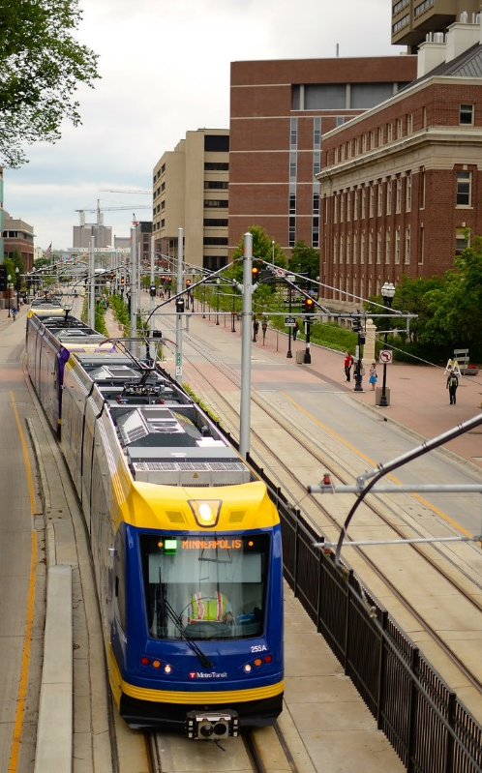
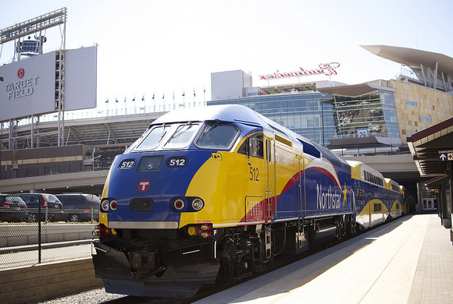
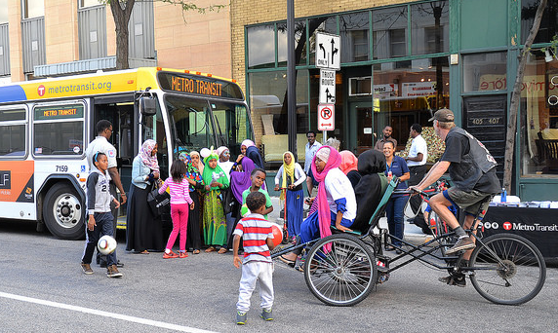
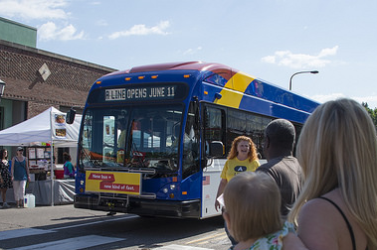
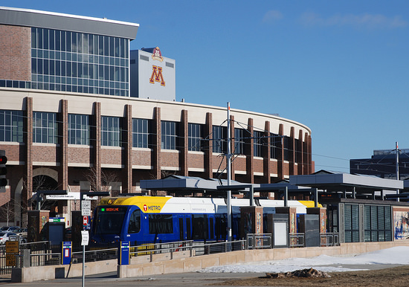
TOD = Connections & Choices
2

Slide 5
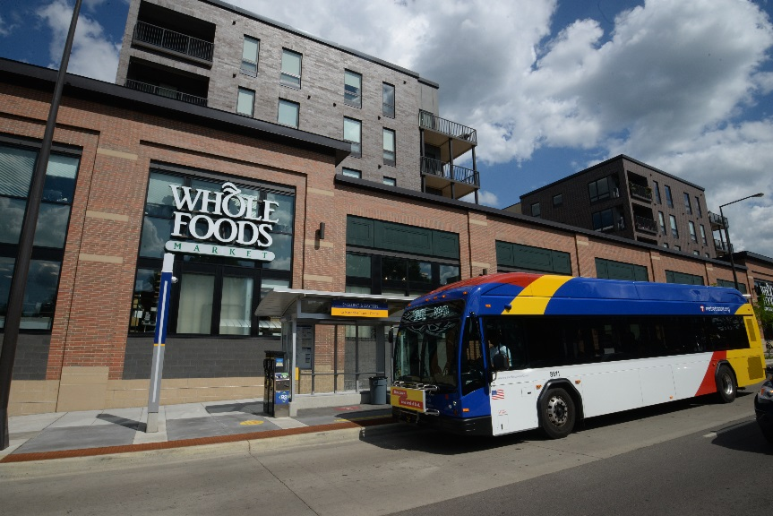
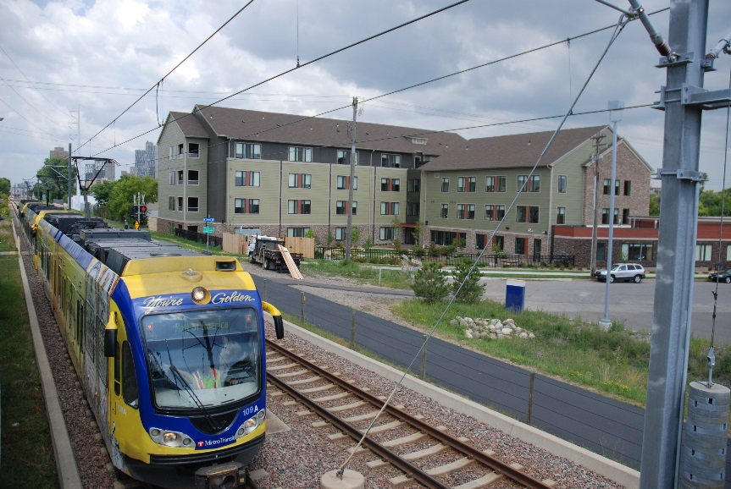
TOD Policy Goals
Maximize the development impact of transit investments
  Community building
Support regional economic competitiveness
  More people connected to jobs
Advance equity
  Housing affordability & job accessibility
Support a 21st century transportation system
  Ridership & revenue

Slide 6
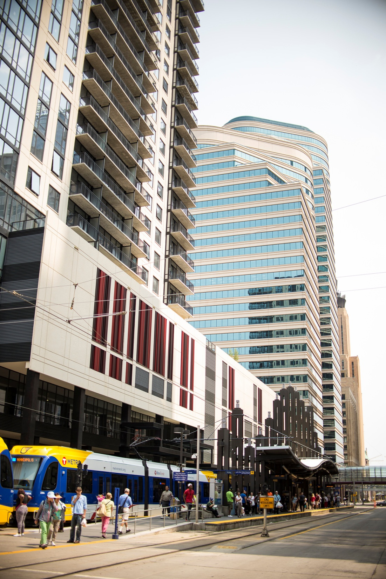
TOD Office Work Program
Projects
  Create TOD on Council-owned land
Programs
  Convene TOD community
  Hold forums on TOD topics
Resources
  Best Practices
  Online public property database
  Regional and national workshops & conferences
Partnerships
  Work with partner jurisdictions on TOD
  Connect the development community with Council resources

Slide 7

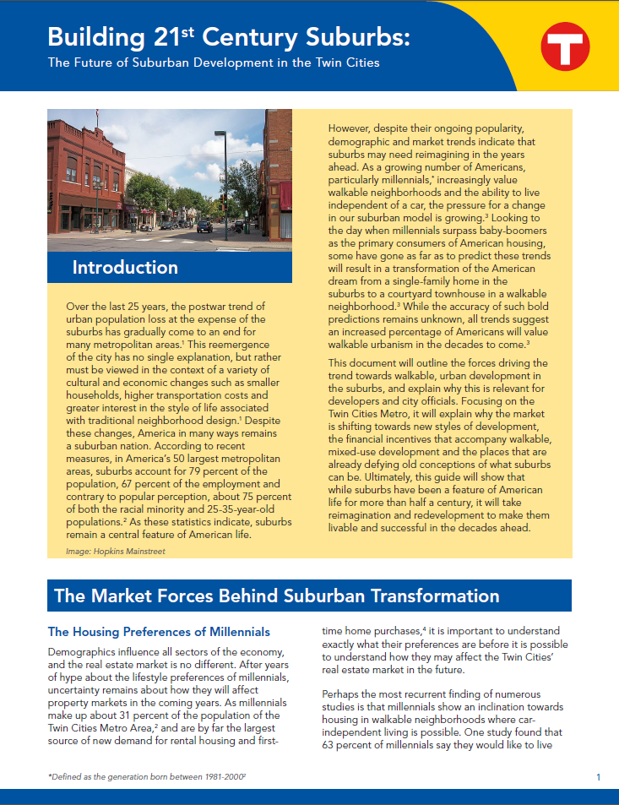

Slide 8
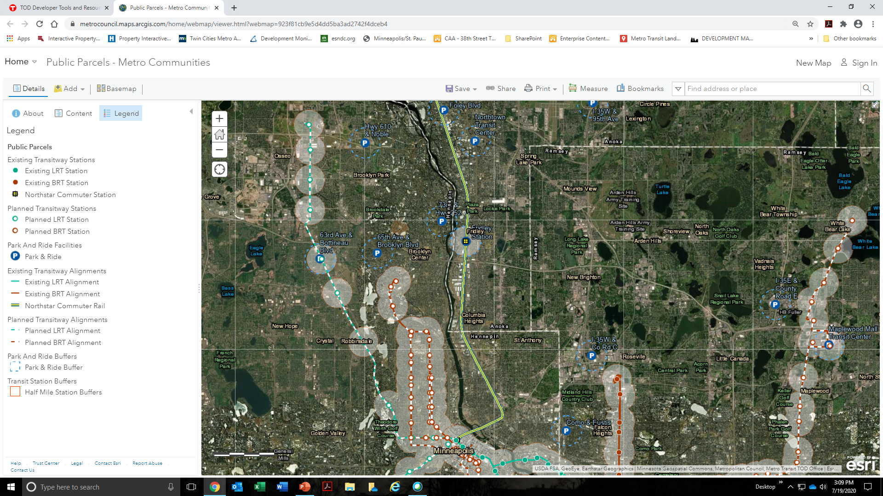
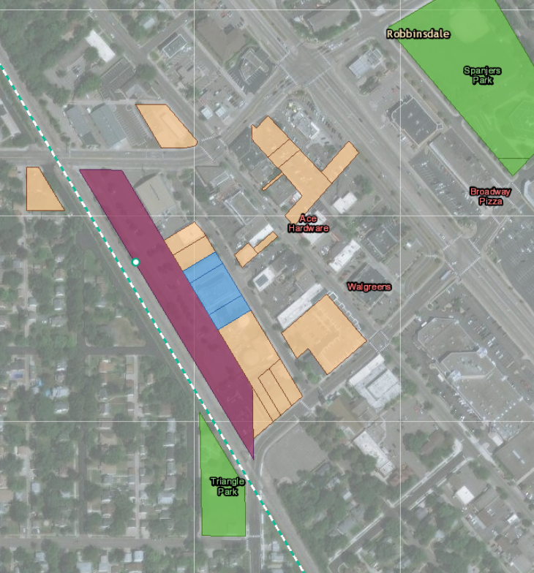

Public Property Database
Station Areas
(½ mile circles)
Robbinsdale Station Area

Slide 9
TOD Funding Guide
2020 updated workbook of potential funding sources and financing tools for projects constructed along TOD corridors for these types of projects:
Infrastructure project financing strategies with focus on bicycle and pedestrian projects
Housing development, especially affordable housing development, (new and rehabilitation)
Commercial and retail projects (new and redevelopment)
Mixed use projects that have corridor-wide potential
Strategic site acquisition strategies for cities to use for all types of developments
DATA Included: Program, Project type, Fund type, Amounts, Agency, Funding amount, Uses, Description, Timing, Who can apply, and contacts information.
Minnesota Historical and Cultural Grants: Minnesota Historical Society
  Small grants (<$10,000) Large Grants (> $10,000)
Intended to preserve and enhance Minnesota's cultural and historical resources, these grants are offered in various categories and for varying amounts.
April Small Grant Application Deadline: Friday, April 10, 2020; Large Grant FY 21 Pre-applications Deadline Friday, May 29, 2020; July Small Grant Application Deadline: Friday, July 10, 2020
Educational organizations and institutions, units of Minnesota state or local government, nonprofit organizations, tribes

Slide 10
Developing Along a Transitway
Kathleen Aho, Principal
Mikaela Huot, Director
Baker Tilly Municipal Advisors, LLC

Slide 11
Development along a Transit Line
Generally
Bottineau Corridor (Blue Line) observations
  Community input
  Station area characteristics

Slide 12
Innovative Financing Strategies for TOD
Financing Tools
  TOD Tool Guide (Task 1)
  Highlighted concepts
Financing strategies for certain types of development (Task 2)
  Infrastructure
  Real estate
  Site acquisition

Slide 13
Innovative Financing Strategies for TOD
Real estate evaluation for individual projects (Task 3)
  Types/Characteristics/Common Denominators
  Challenges presented
  Financial evaluation/observations
  Type of projects seen in other communities
    Existing Met Transit lines
    Other Metro areas

Slide 14
Innovative Financing Strategies for TOD
Commercial affordability (Task 4)
  What does the community need?
  What is the market saying?

Slide 15
What Types of Innovative Financing Strategies were Discovered with this Project?
Some similar, existing tools with greater flexibility and use
  For example, value capture strategies like tax increment financing
Community based programs such as:
  Community land trusts
  Community-owned businesses
Philanthropic to promote collaboration
  Public – private – community

Slide 16
What Types of Innovative Financing Strategies were Discovered with this Project?
Strategies specific to types of development including:
  Infrastructure
  Real estate (housing and commercial)
  Acquisition

Slide 17
What are some strategies for providing 1st floor retail or active 1st floor uses?
Communities are striving for mixed-use TOD
Challenges associated with mixed-use
Focus on programs that are financially viable, vibrant and provide diverse range of needs

Slide 18
What are some strategies for providing 1st floor retail or active 1st floor uses?
Community-owned businesses may have variety of funding options:
  Small Business Administration loans and other similar programs
  Angel investors (higher rate of return required)
  Social impact investors (lower rate of return required)
  Program Related Investments from foundation (lower rate of return required)
  Direct grants to assist in establishing the organization or employing low-income individuals

Slide 19
What are some strategies for providing 1st floor retail or active 1st floor uses?
Value capture tools
Revolving loan funds
Business incubator
Rent control
Community benefits agreement

Slide 20
Are there more gaps in financing/funding TOD projects and if so, why?
Generally, because:
  Projects not supported by market
    Housing options
    Retail
    Office
  Enhanced infrastructure
    Parking
    Pedestrian/bike way

Slide 21
What are recommended best practices when working to get a deal done?
Communication
Understanding of local public policy and objectives
Shared vision of development/redevelopment
Innovative use of financing tools and funding sources

Slide 22

Q&A
Q&A Panel
Choose “All Panelists”

Slide 23
Panelists
Denise Butler, African Career, Education & Resource, Inc.
Maureen Michalski, Ryan Companies
Leah Stockstrom, CommonBond Communities
Kent Carlson, Inland Development Partners
Marcia Glick, City of Robbinsdale
John Sutter, City of Crystal
Bill Mague, AEON

Slide 24
Thank you
Lucy Galbraith, TOD, Metro Transit
Marcia Glick, City of Robbinsdale
Kathleen Aho, Baker Tilly
Bill Mague, AEON
Mikaela Huot, Baker Tilly
Maureen Michalski, Ryan Companies
Denise Butler, African Career, Education & Resource, Inc.
Leah Stockstrom, CommonBond Communities
Kent Carlson, Inland Development Partners
John Sutter, City of Crystal

