Slide 1
Community & Business Advisory Committee
Meeting #9 | April 24 & 26, 2024

Slide 2
Welcome & Introductions
Liz Jones | Senior Community Outreach Coordinator

Slide 3
Today’s Topics
Welcome & Introductions
Project Updates
Center-running option in St. Paul
Arcade St. Station
Purple Line as a Small Starts Project
Upcoming CBAC Meetings
Q & A

Slide 4
Housekeeping
Virtual meeting etiquette
Camera on
Microphone (muted when not speaking)
Raise hand (if you have a question)
Chat (feel free to ask questions in the chat)
Meeting is being recorded
Meeting agendas, summaries, and presentation materials are posted on the project website at metrotransit.org/purple-line-project-committees

Slide 5
Center-Running Option in St. Paul
Sara Pflaum | Engineering & Design Manager​
Notes:
The Route Modification Study Phase II is studying an alternative route using Maryland and White Bear avenues to travel to the Maplewood Mall area instead of the route through the Bruce Vento Regional Trail Corridor, north of Maryland Avenue. During today's presentation we will review the study process to date, identifying options to be studied to determine the best White Bear Avenue options. Then, the study will compare this option to be previous studied alternative on the Bruce Vento Trail corridor to determine which provides the greatest benefit to area residents and businesses.

Slide 6
Third Option in St. Paul Section
The Saint Paul section is Maryland and White Bear avenues between Johnson Parkway and Larpenteur Avenue.
There are three options in this section.
One Side-Running Transit Lane
Two Side-Running Transit Lanes
Center-Running Transit Lanes
New Design Option Under Evaluation

Slide 7
CMC Concurrence at 4/4 Meeting: Center Running Option in St. Paul
CMC concurred on 4/4 to study a narrowed center running option further
Project team is developing cross sections, layouts, property impacts assessment, and assessment of tradeoffs for public feedback this spring/summer
Previously anticipated May 2 CMC action on a preferred White Bear Ave Corridor roadway and transit design option will be postponed

Slide 8
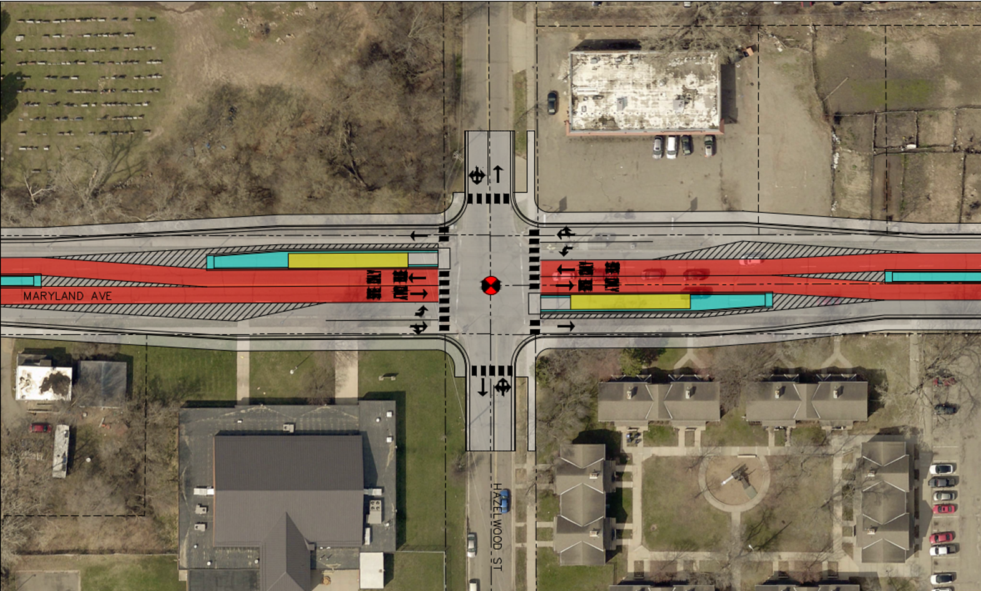
Center Running in St. Paul example: Hazelwood Split Center

Slide 9
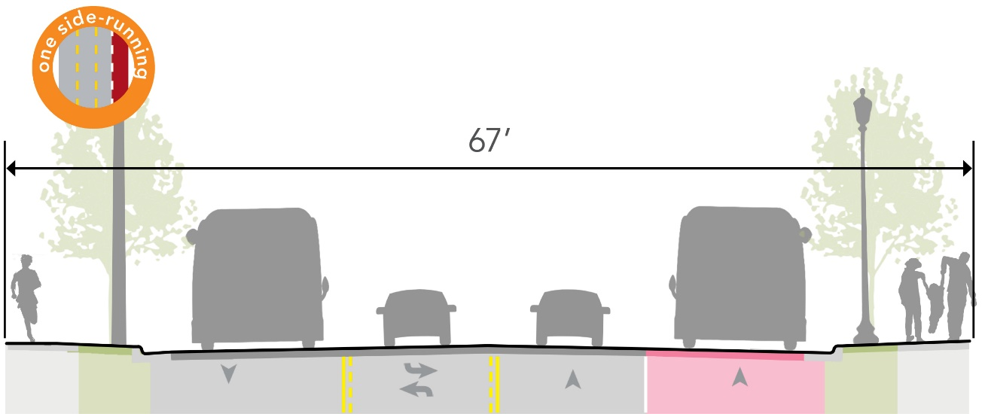
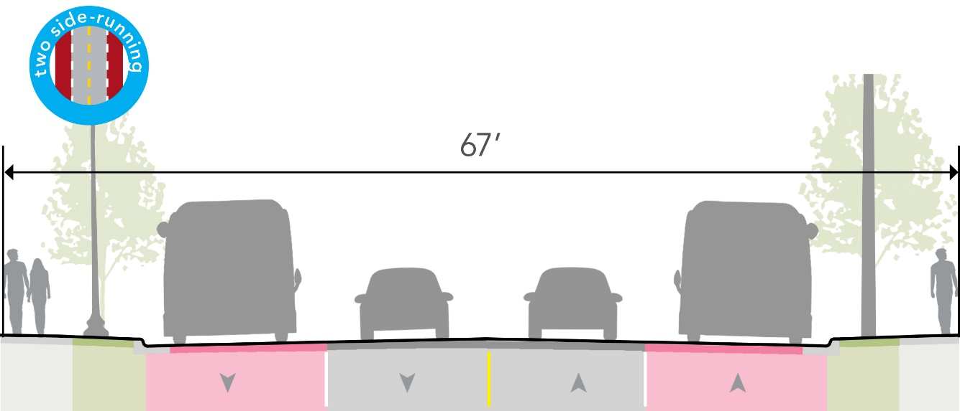
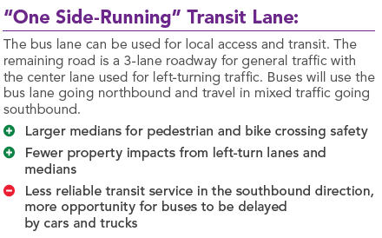
Design Options in the St. Paul Section
Notes:
Encourage comments in the chat about the impression.

Slide 10
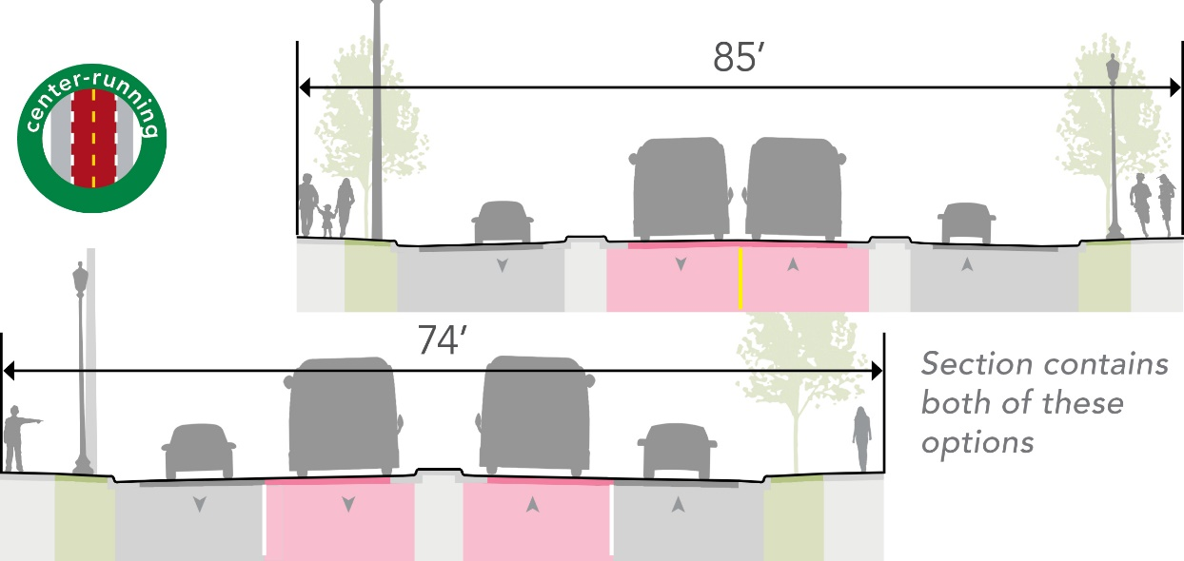
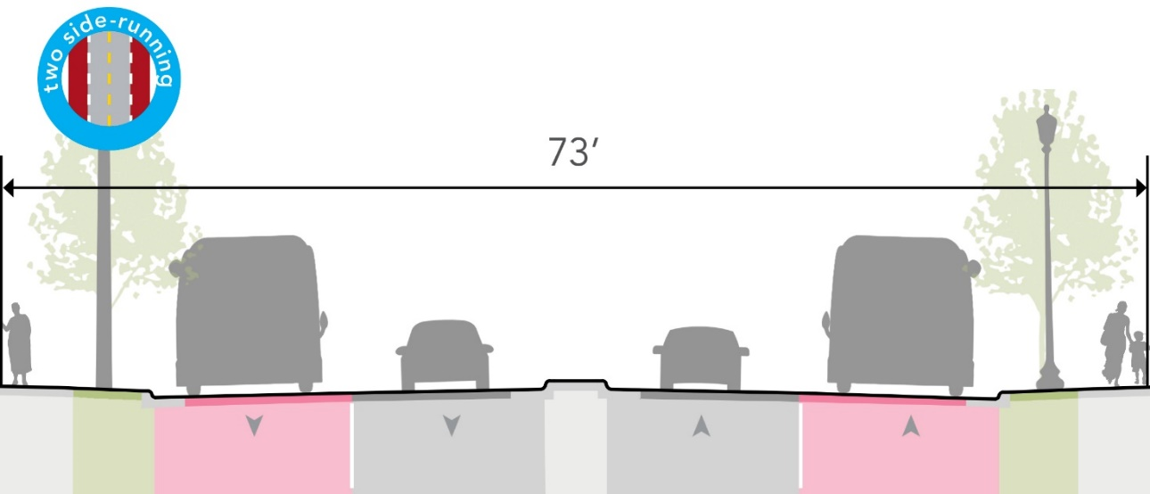
Two Options in the Maplewood Section

Slide 11
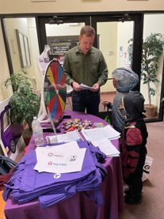
Upcoming RMS Phase II Engagement this Summer
Engagement on center running option in St. Paul
Engagement over Bruce Vento Regional Trail Collocation and the White Bear Avenue Corridor Route Alternatives; Solicit preference for a Purple Line BRT Route

Slide 12
Arcade Street Station
Sara Pflaum | Engineering and Design Manager

Slide 13
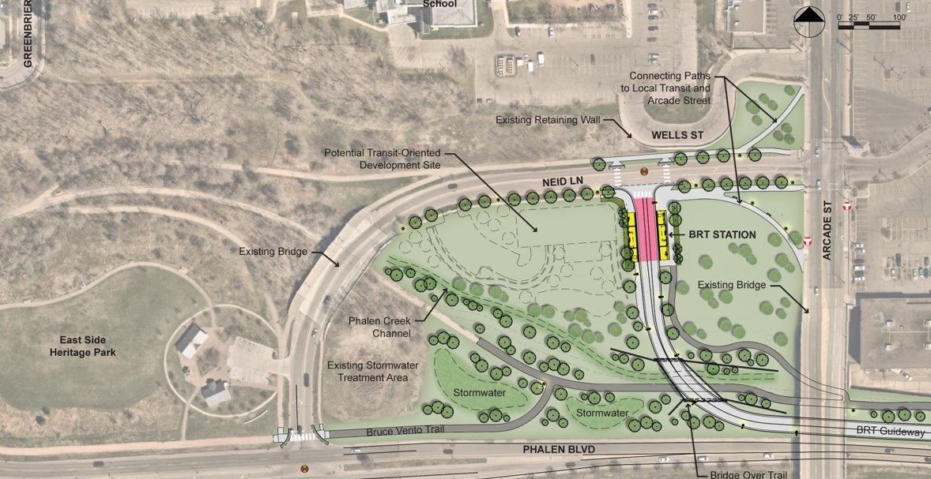
Arcade St. Station with Guideway Under Bridge
Option 1
Notes:
Project team continuing to advance Arcade St. Station engineering from 15% design (Dec. 2023) to 30% design (May 2024)

Slide 14
Arcade St. Station with Guideway Under Bridge (cont.)
Option 1
Notes:
Looking for CBAC feedback on vantage points for A2

Slide 15
Arcade St. Station with Guideway Under Bridge (cont.)

Slide 16
Arcade St. Station with Guideway Under Bridge (cont.)

Slide 17
Study Model
Notes:
Notes: Study model does not reflect the current site plan design as shown on slide 18. Updated site plan has a pedestrian connection from under the Arcade bridge to the station platform

Slide 18
Study Model

Slide 19
Study Model
Notes:
View from Arcade bridge looking to station platform

Slide 20
Study Model
Notes:
View from trail along Phalen Blvd to station platform

Slide 21
Study Model
Notes:
View from Wells St retaining wall to station platform

Slide 22
Site Redevelopment Feasibility Study
Community leaders continuing to advocate for a station located at the Arcade St. & Neid Ln. intersection
Work order issued to HR&A Advisors (Real Estate & Economic Development) for a Site Redevelopment Feasibility Analysis (March – June)
Lead and funded by the Purple Line BRT project
Participants: Metro Transit TOD Office, Met Council Real Estate Office, Ramsey County, City of Saint Paul (Planning & Economic Development, Housing & Redevelopment Authority), Saint Paul Port Authority, Community Councils (Payne-Phalen, Dayton’s Bluff), East Side Area Business Association
Property owner engagement (early July)
Discuss potential site redevelopment under A2 and Neid Ln. Extension to Phalen Blvd. options

Slide 23
Study Goals
Understand redevelopment potential of Glimcher Group and City of Saint Paul properties under A2 and Neid Ln. extension to Phalen Blvd. scenarios
Takes into account costs of constructing envisioned redevelopment and current market assumptions around rents, leasing trends, vacancy, and financing rates
Outcomes include potential financial return to Glimcher Group and public investment required under each scenario
Engage Payne-Phalen District Council, ESABA, and City of Saint Paul in discussing TOD implications of each scenario
Agreement on need to include affordable housing and ground-level retail
Present outcomes to Glimcher Group to gauge interest in Neid Ln. Extension to Phalen Blvd.

Slide 24
Neid Ln. extension to Phalen Blvd.
Glimcher Group
redevelopment area
City of Saint Paul
redevelopment area
Option 1
Notes:
Emma to talk to this slide

Slide 25
Neid Ln. extension to Phalen Blvd.
Glimcher Group
redevelopment area
City of Saint Paul
redevelopment area
Option 1
Notes:
Emma to talk to this slide

Slide 26
Purple Line as a Small Starts Project
Stephen Smith | Deputy Project Manager

Slide 27
New Starts vs Small Starts
Will need to transition from New Starts to Small Starts to remain viable
Project’s scope will need to be reduced to maintain future federal funding eligibility
Elements funded outside of the project by other entities or not implemented at all
See April 4 CMC presentation for a deeper dive on this topic
Notes:
Pull talking points from slide 29 into this slide
Regional New Starts Projects: Blue Line, Northstar, Green Line, Green Line Extension, Gold Line, Blue Line Extension
Regional Small Starts Projects: Orange Line, F Line

Slide 28
Upcoming CBAC Meetings
Liz Jones | Community Outreach & Engagement Lead

Slide 29
CBAC Meeting Look Ahead
Meetings have been scheduled through Sept. 2024 (2 options each time)
Agenda topics for each meeting will be shared in advance
Date Range for Meetings
5/27-6/5
6/26-7/3
7/24-8/2
8/28-9/4
9/23-9/27

Slide 30
Contact Us
For more information:
www.metrotransit.org/purple-line-project
Facebook and X/Twitter @PurpleLineBRT
Craig Lamothe
Project Manager
(651) 602-1978
craig.lamothe@metrotransit.org
Liz Jones​
Community Outreach & Engagement Lead​
(651) 602-1977​
elizabeth.jones@metrotransit.org​
Colin Owens
Associate Community Outreach Coordinator
(612) 618-0495
colin.owens@metrotransit.org

