Slide 1

METRO H Line Draft Corridor Plan
Transportation Accessibility Advisory Committee | April 1, 2026

Slide 2
H Line identification history
2019-2021: Network Next established the next three BRT lines (F, G, and H lines)
  Four step process evaluated 19 candidate corridors, narrowed down to identify three
  Multiple technical evaluation and engagement periods between Fall 2019 and Spring 2021
March 2021: Como/Maryland corridor identified as the METRO H Line and adopted by the Metropolitan Council
H Line subsequently adopted into the regional Transportation Policy Plan

Slide 3
METRO H Line
8th arterial BRT line in the METRO network
Downtown Minneapolis to Sun Ray Transit Center on Saint Paul’s East Side
New crosstown service filling a gap along Maryland Ave
Connects to existing and Planned METRO lines
  A Line, E Line, Green Line, and Gold Line
  Future F Line, G Line, Bronze Line, and Blue Line Extension

Slide 4
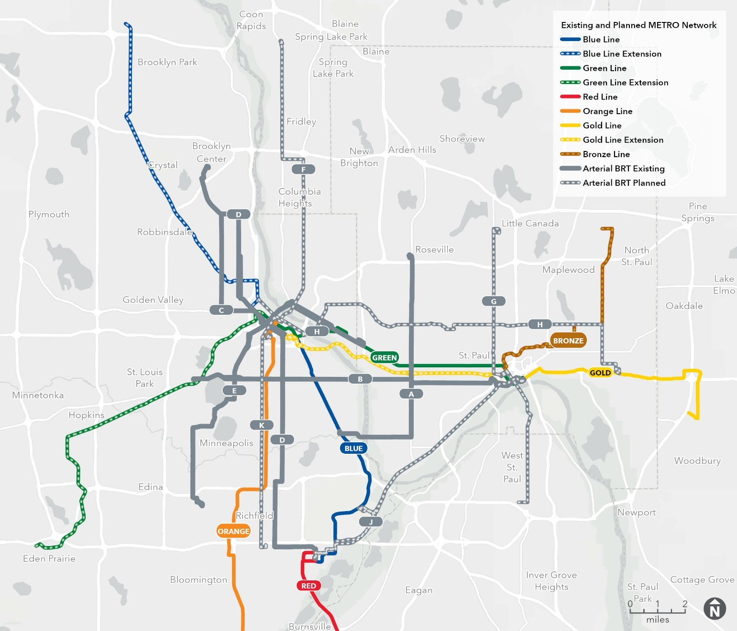
METRO network map

Slide 5
H Line route overview
Fast, frequent, all-day service
17-mile BRT line
  Primarily on Washington, Como, Maryland, and White Bear avenues
45 proposed BRT stations
  3 shared with Bronze Line on Maryland Avenue
Planned to upgrade and replace existing Route 3, with modifications to other routes
Notes:
Route 80 replaced by H Line and Bronze Line
Route 3B replaced by route 66

Slide 6
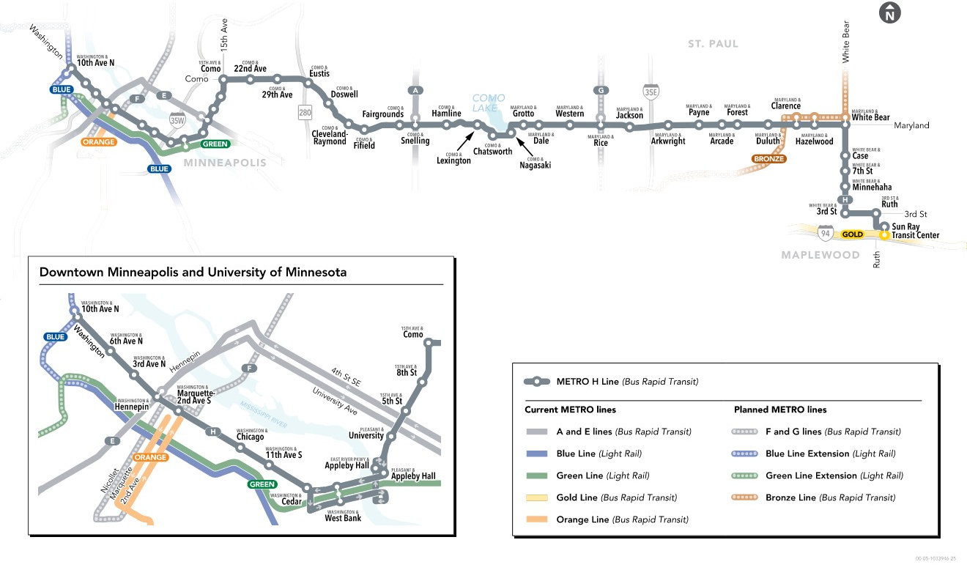
H Line corridor map

Slide 7
A faster, more reliable ride
2-3 stations per mile for less stopping and faster trips
Near-level curb for faster and more accessible boarding
Fares paid before getting on the bus
All door boarding for quicker stops
Transit signal priority to keep buses moving
Faster, frequent, all-day service
Notes:
20-25% faster than existing local bus

Slide 8
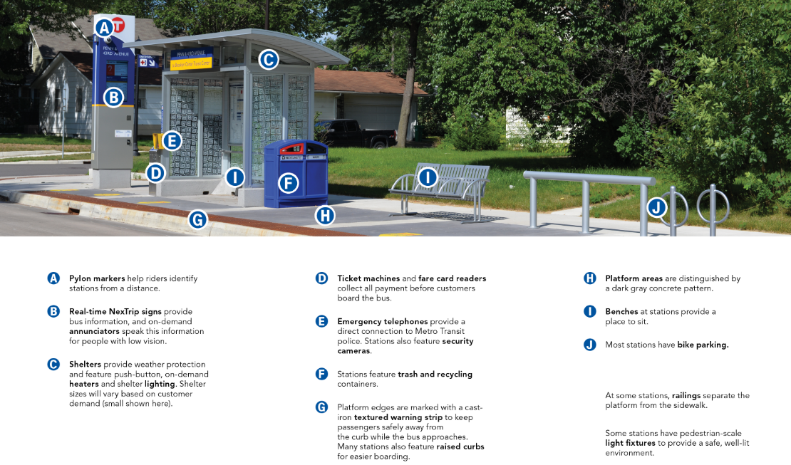
An improved experience at the station and on the bus
A: Pylon Markers
B: Real-time NexTrip signs w/ on-demand audible announcements
C: Shelters
D: Ticket machines & fare card readers
E: Emergency telephone
F: Trash and recycling containers
G: Textured warning strip
H: Platform is dark gray concrete pattern
I: Benches
J: Bike parking
Notes:
Also included at station platforms:
Push button heating
Lighting
9” curbs for near level boarding - enables easier boarding and alighting for folks with mobility limitations while still allowing ramp deployment

Slide 9
H Line project schedule (subject to change)
H Line identified: March 2021
Early project coordination: 2024-2026
Draft Corridor Plan: Comment period Mar. 23 – May 4, 2026
Recommended Corridor Plan: Comment period August 2026
Final Corridor Plan approved: Fall 2026
Engineering: 2026-2027
Construction: Starting 2028

Slide 10
Planning phase – focus is on station locations
Identify, evaluate, and finalize station and platform locations
Corridor Plan establishes policy basis for H Line station locations
Engage riders and the public
  Share information about the project and how to participate
  Collect input and feedback to shape the contents of the Corridor Plan
Gather input and coordinate with agency and public partners
  Saint Paul, Ramsey County, Minneapolis, Hennepin County, MnDOT, U of M, MPRB

Slide 11
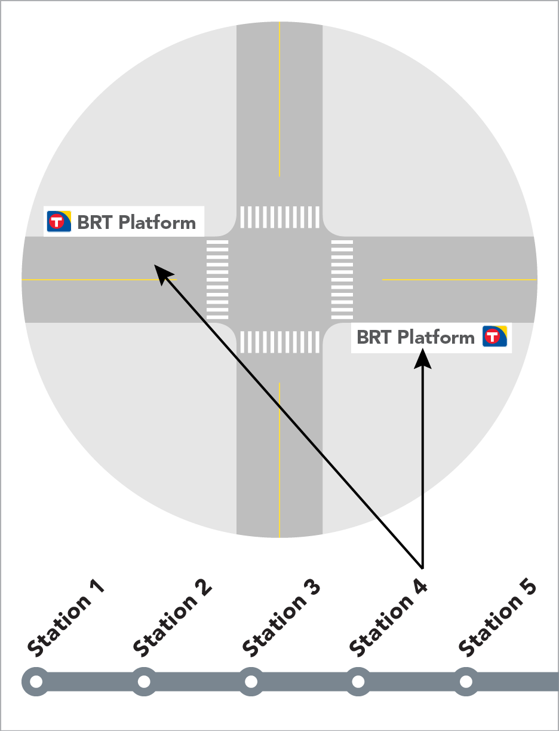
What is included in the Corridor Plan?
Proposed station locations
Proposed platform locations within the station intersection
Information about how and why proposed locations were determined

Slide 12
Draft Corridor Plan proposed station and platform locations
Station concepts illustrating platform locations in context
Coordinated project information
Station and platform designs will be finalized during the engineering phase (2026-2027)

Slide 13
Draft Corridor Plan public comment period
6-week public comment period:
March 23 – May 4
Preceded by several months building awareness about the project
  Community spaces, events, and neighborhood organizations
  In-reach with Metro Transit operators
Survey used as primary tool for collecting input – online and paper versions

Slide 14
Public engagement strategies
Our goal is to collect feedback via online and in-person surveys
Engage riders on buses and at bus stops
Postcard mailed to all homes, businesses, and property owners along the corridor
  Followed by supplemental letter with more detailed information to neighbors nearest stations
Targeted door knocking
Lawn signs and flyering
  In several languages

Slide 15
Project partners
Collaboration with: Hennepin County, Ramsey County, City of Minneapolis, City of St. Paul, University of Minnesota, and Minneapolis Park and Rec Board
Blue Line Extension
Washington Ave Bikeway Project
Como Ave SE Corridor Improvements
Maryland Ave Corridor Study
Bronze Line
White Bear Ave Corridor Study
Reconstructing all non-compliant curb ramps at every quadrant of every station location

Slide 16
Corridor Plan next steps
This is the first of two public comment periods
Public comment period #2: August – September 2026
Final corridor plan approved: Fall 2026
Subject to change

Slide 17

Help us plan H Line station locations
metrotransit.org/h-line-project
Review the Draft Corridor Plan and share your feedback
  Complete our survey
  HLine@metrotransit.org
Comment by May 4
Sign up for the H Line Update newsletter

