Slide 1
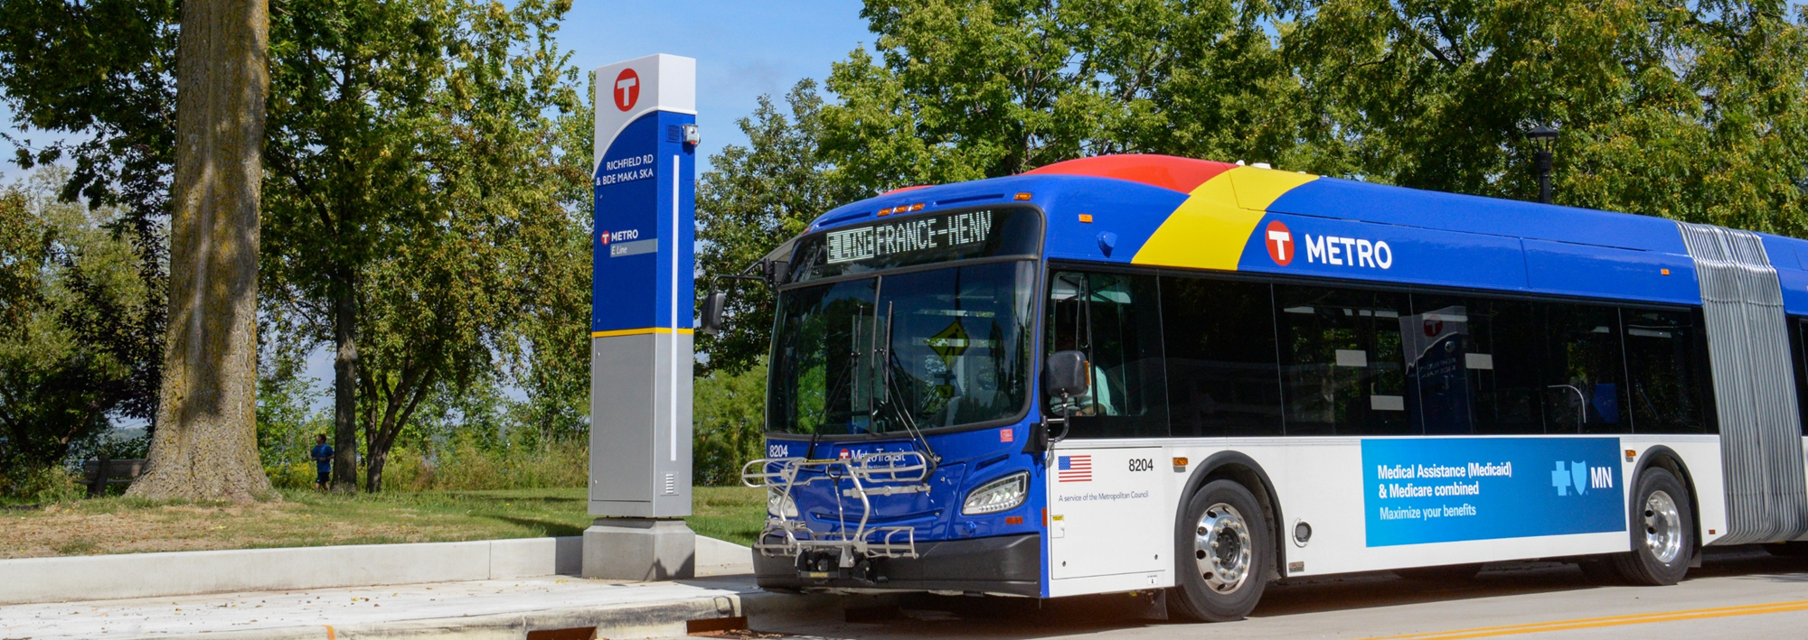
METRO H Line - Draft Corridor Plan
Southeast Community Organization (SECO), District 1
March 24, 2026

Slide 2
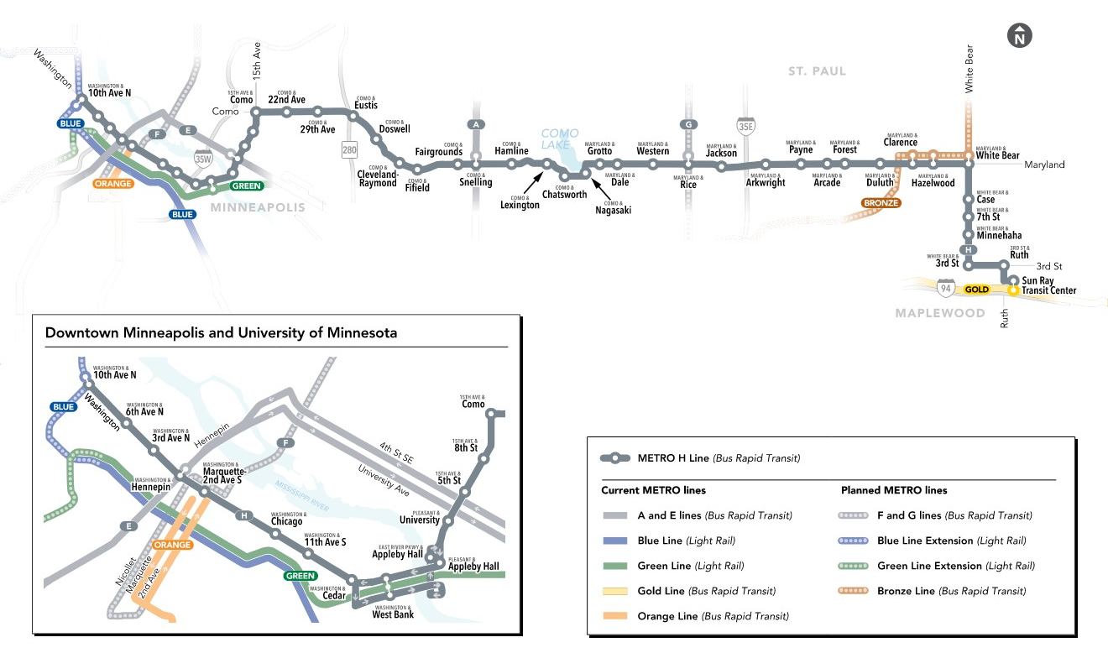
METRO H Line bus rapid transit (BRT)
Fast, frequent, all-day service
BRT buses and stations that are comfortable and easy to use
17-mile BRT line
  Sun Ray Transit Center to downtown Minneapolis
  Primarily on White Bear, Maryland, Como, and Washington avenues
45 proposed BRT stations
Planned to upgrade and replace existing Routes 3 and 80, with modifications to other routes

Slide 3
METRO H Line bus rapid transit (BRT)
Within District 1:
Operating on White Bear Ave, 3rd St, and Ruth St to Sun Ray Transit Center

Slide 4
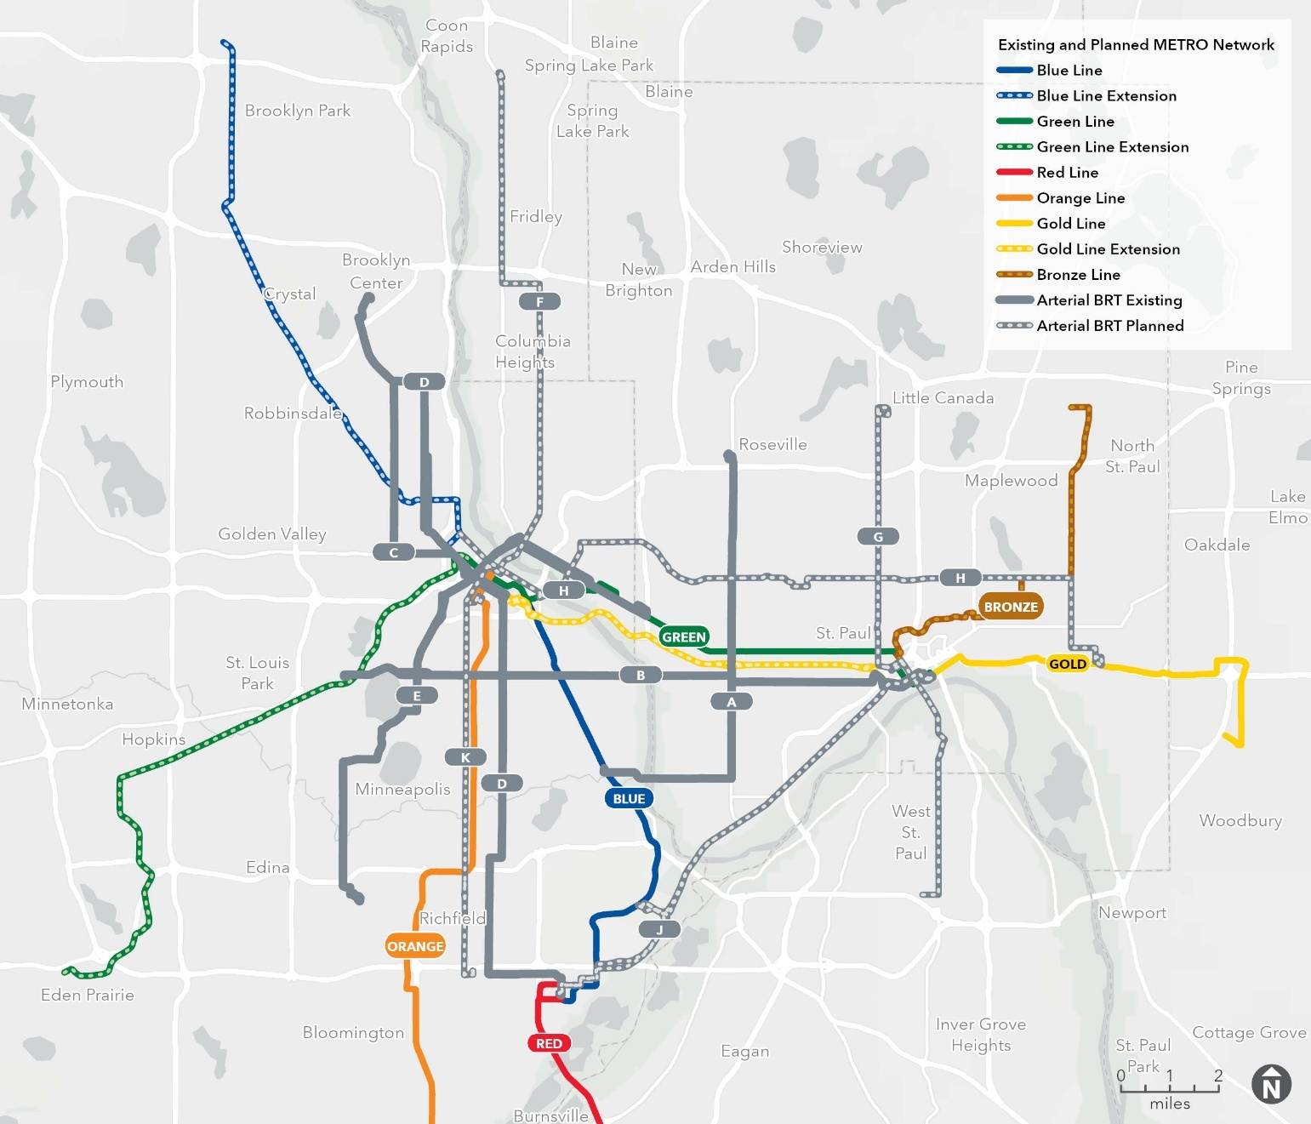
Expanding the
METRO network
8th arterial BRT line in the METRO network
New crosstown service filling a gap along Maryland Ave from Rice St to Payne Ave
Connecting with most existing and planned METRO lines

Slide 5
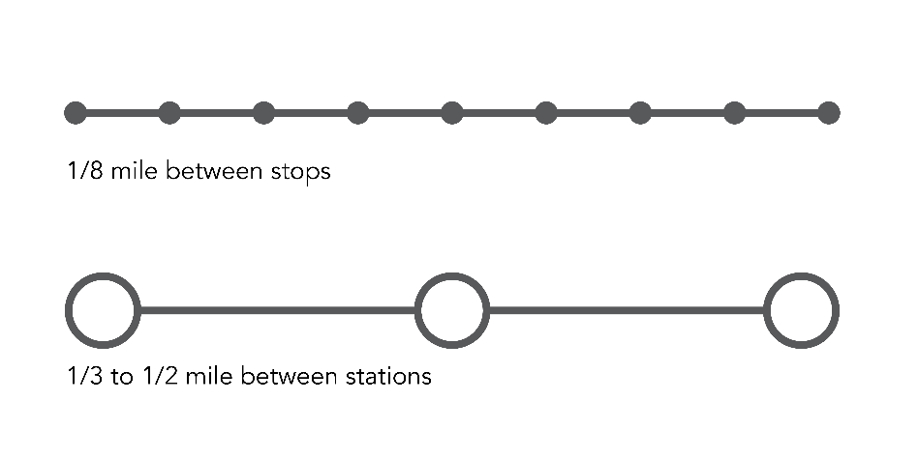
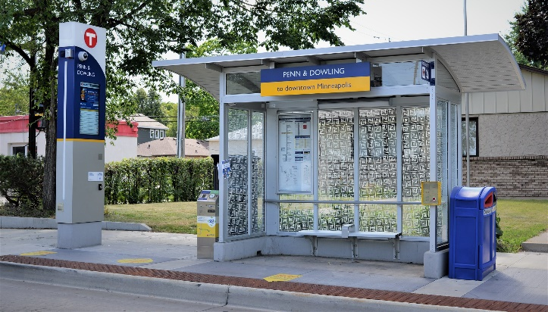
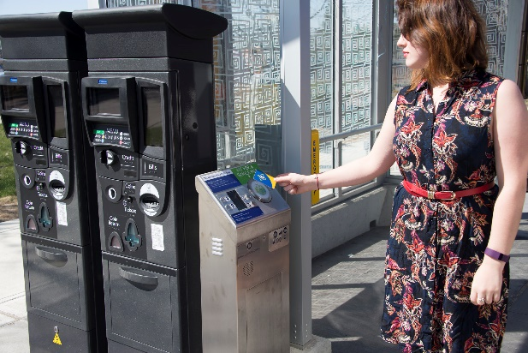
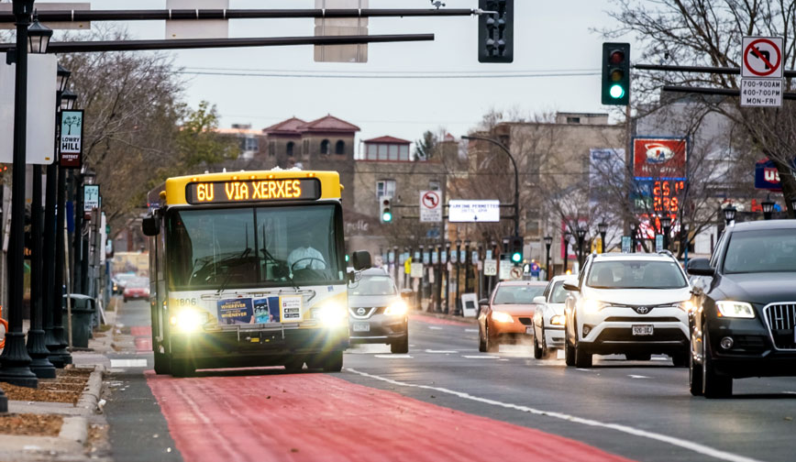

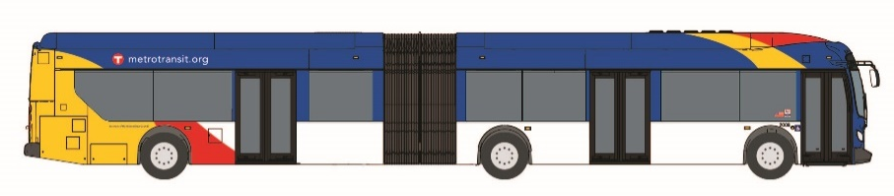
Arterial BRT:
Designed to be faster, more reliable, and easy to use
metrotransit.org/brt
2-3 stations per mile for faster trips
High-tech, high-amenity, secure stations
Pre-boarding fare payment for faster stops
High-capacity buses & boarding through all doors
Bus priority signals & lanes
Faster, frequent, all-day service

Slide 6
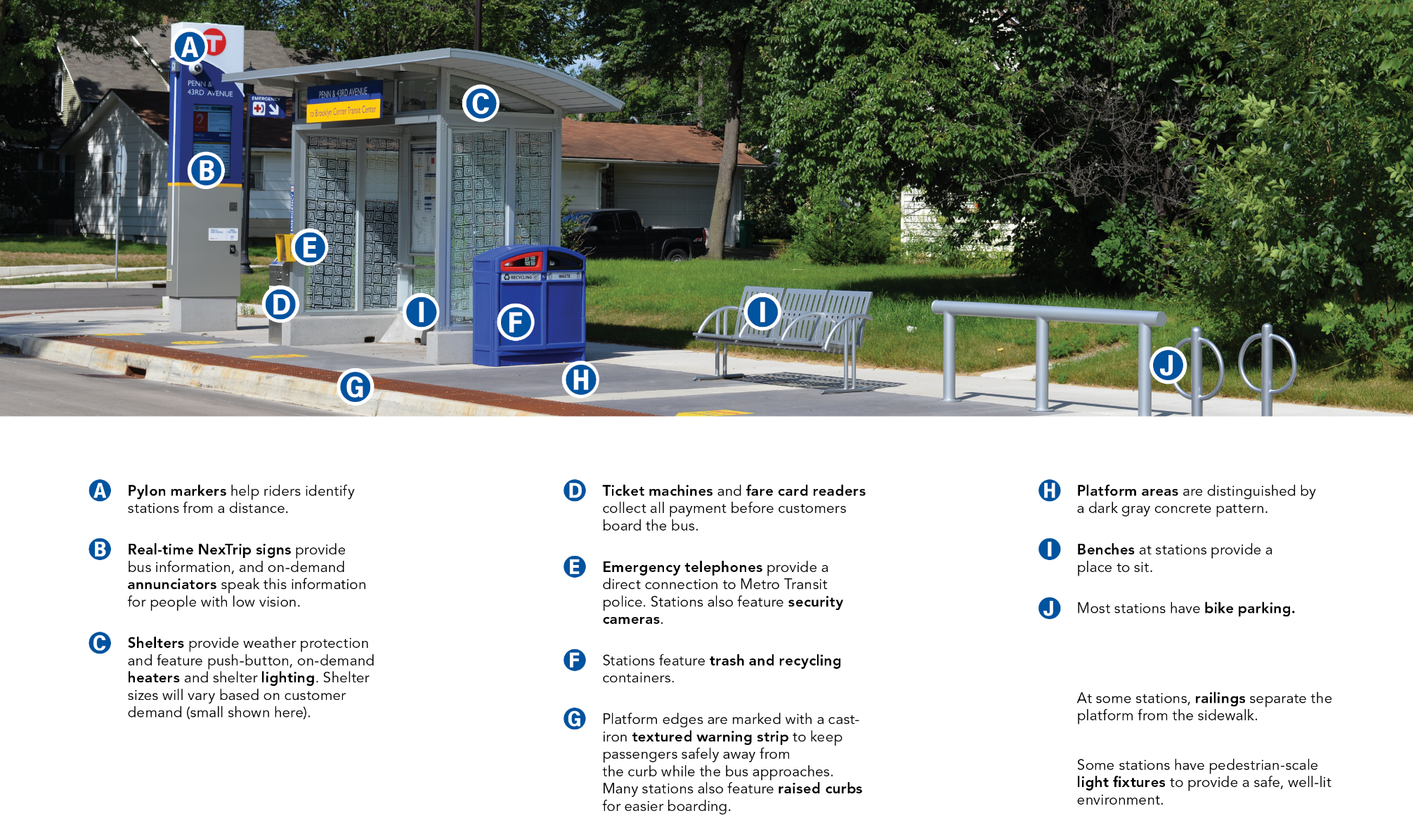
What will H Line stations look like?

Slide 7
H Line project schedule
H Line identified: March 2021
Early project coordination: 2024-2026
Draft Corridor Plan: Comment period Mar. 23 – May 4, 2026
Recommended Corridor Plan: Comment period
August 2026
Final Corridor Plan approved: Fall 2026
Engineering: 2026-2027
Construction: Starting 2028
Planning phase
We are here
Looking for community input to select H Line station locations
Community engagement
Subject to change

Slide 8
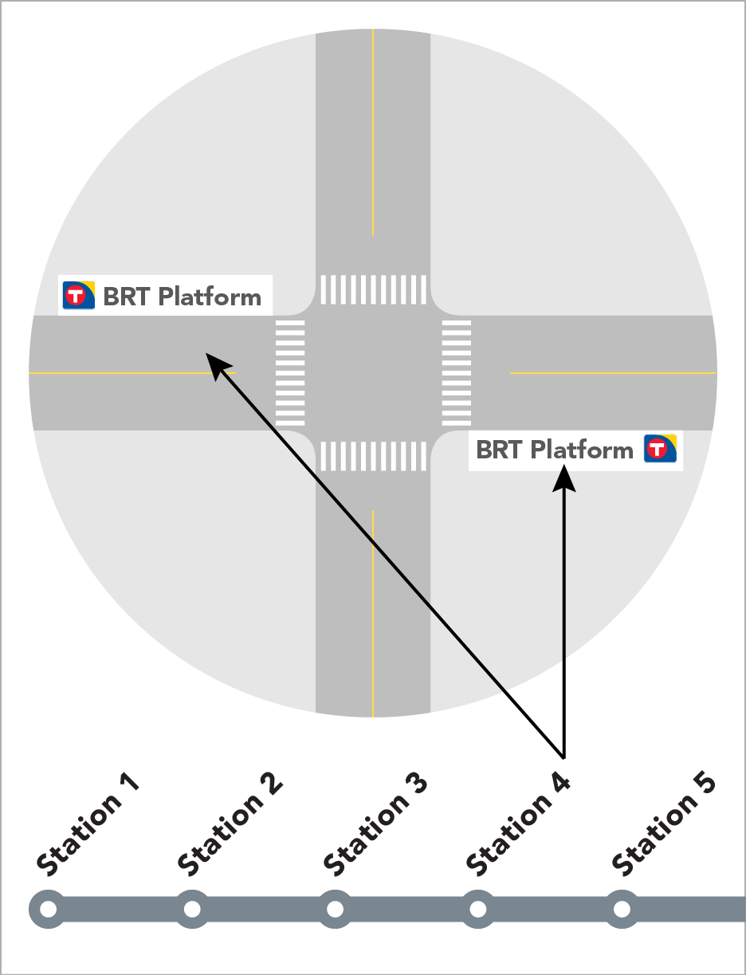
What is included in the Corridor Plan?
Proposed station and platform locations
Information about how and why proposed locations were determined
Proposed service changes
Coordinated project information
Summary of engagement

Slide 9
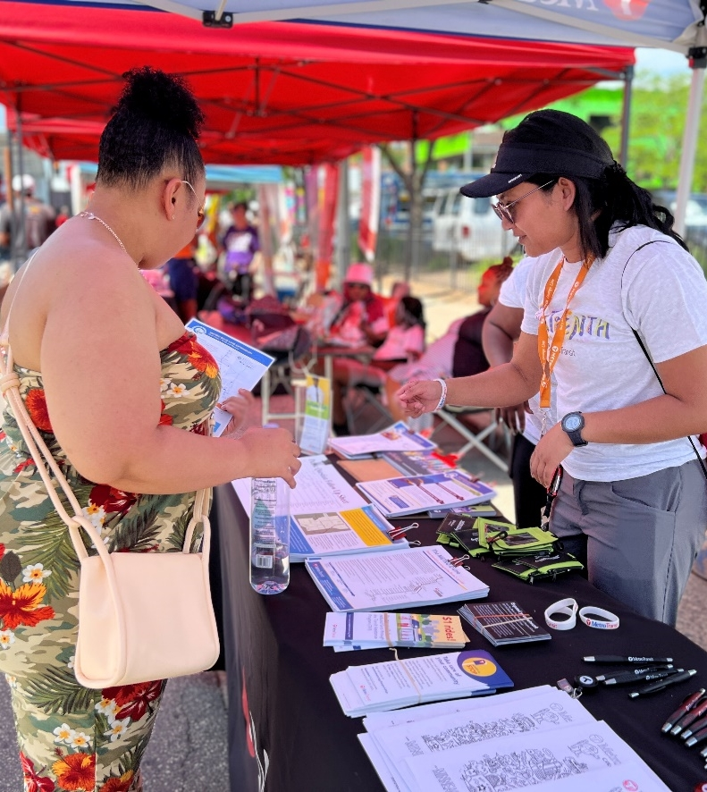
Draft Corridor Plan public comment period
6-week public comment period:
March 23 – May 4
Strategies: Postcards, flyers, intercepts at bus stops, door knocking, community events & meetings, pop-ups tabling, etc.
Survey used as primary tool for collecting input – online and paper versions
All materials are translated

Slide 10
H Line within District 1

Slide 11
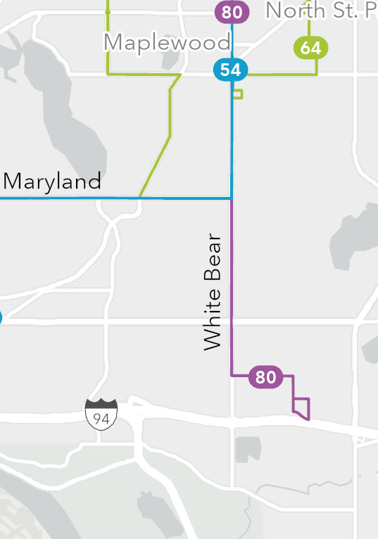
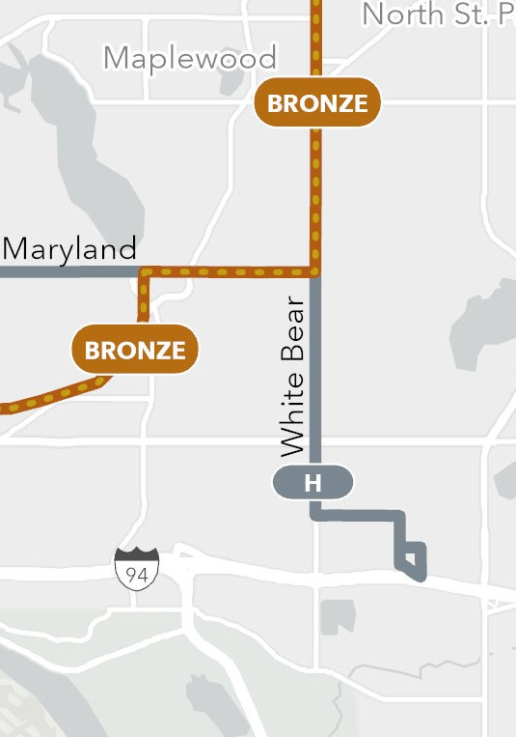
H Line near District 1: Service
Existing Route 80 replaced by H Line and Bronze Line
  Increased service along White Bear Ave corridor
Subject to change, refined as project progresses
Sun Ray
Sun Ray
Existing
Proposed

Slide 12
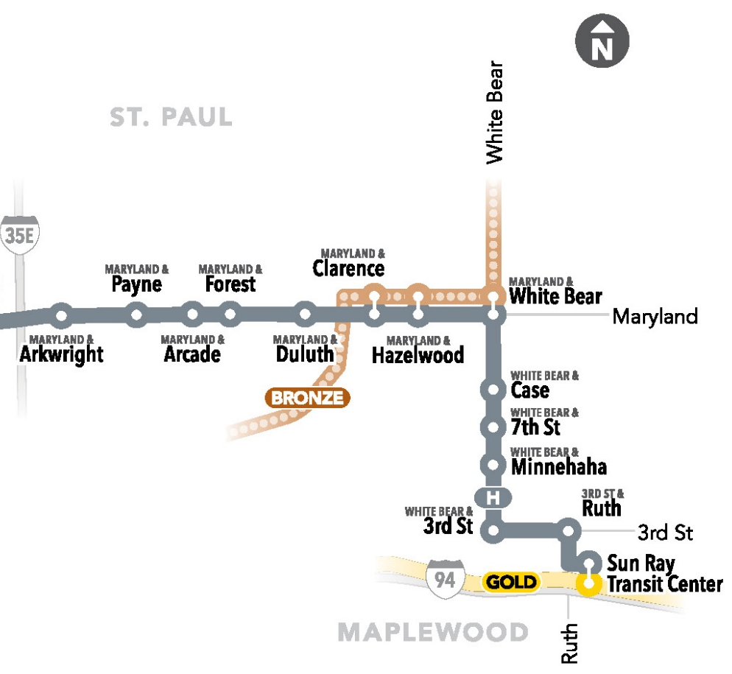
H Line within District 1: Stations
Four proposed H Line stations within District 1
  White Bear & Minnehaha
  White Bear & 3rd St
  3rd St & Ruth
  Sun Ray Transit Center
Subject to change

Slide 13
Factors influencing station locations
Pedestrian safety
Spacing
Transit speed and reliability
Existing ridership
Transit connections
Destinations
Community feedback
Street design
Available right-of-way
Coordinated projects

Slide 14
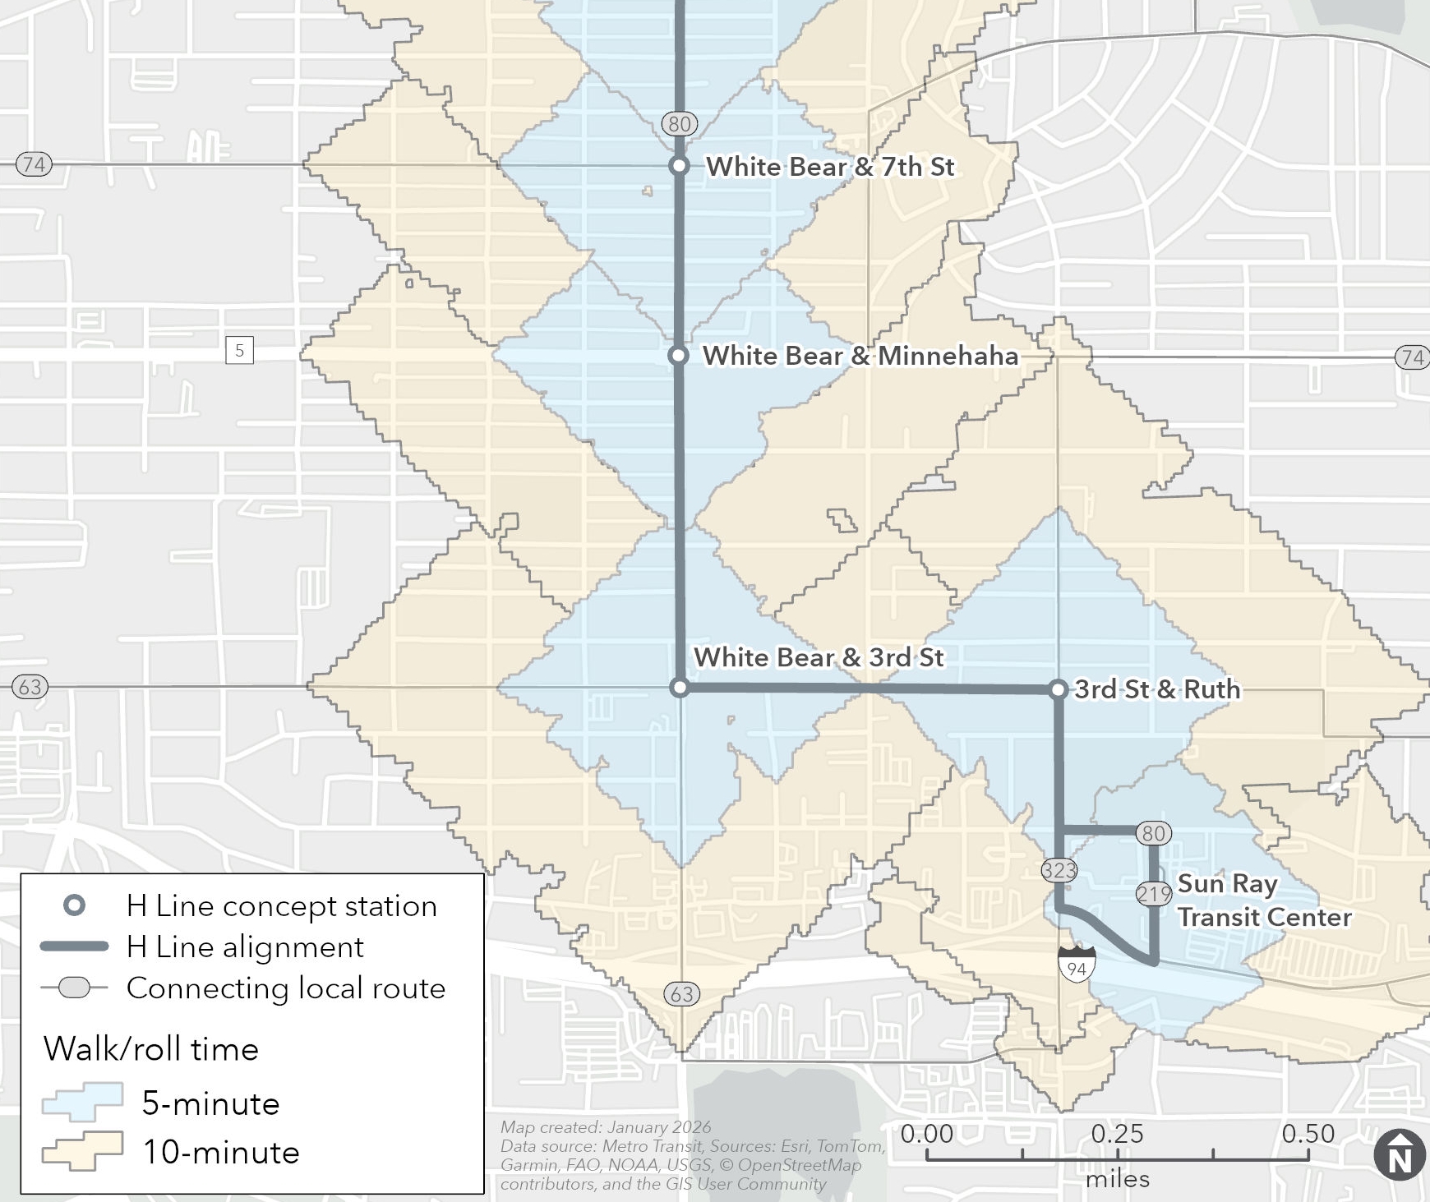
Station spacing
Four proposed H Line stations within District 1
  White Bear & Minnehaha
  White Bear & 3rd St
  3rd St & Ruth
  Sun Ray Transit Center
Walk/roll sheds from stations
  Approximate area someone could walk or roll within 5 minutes and 10 minutes from proposed H Line stations

Slide 15
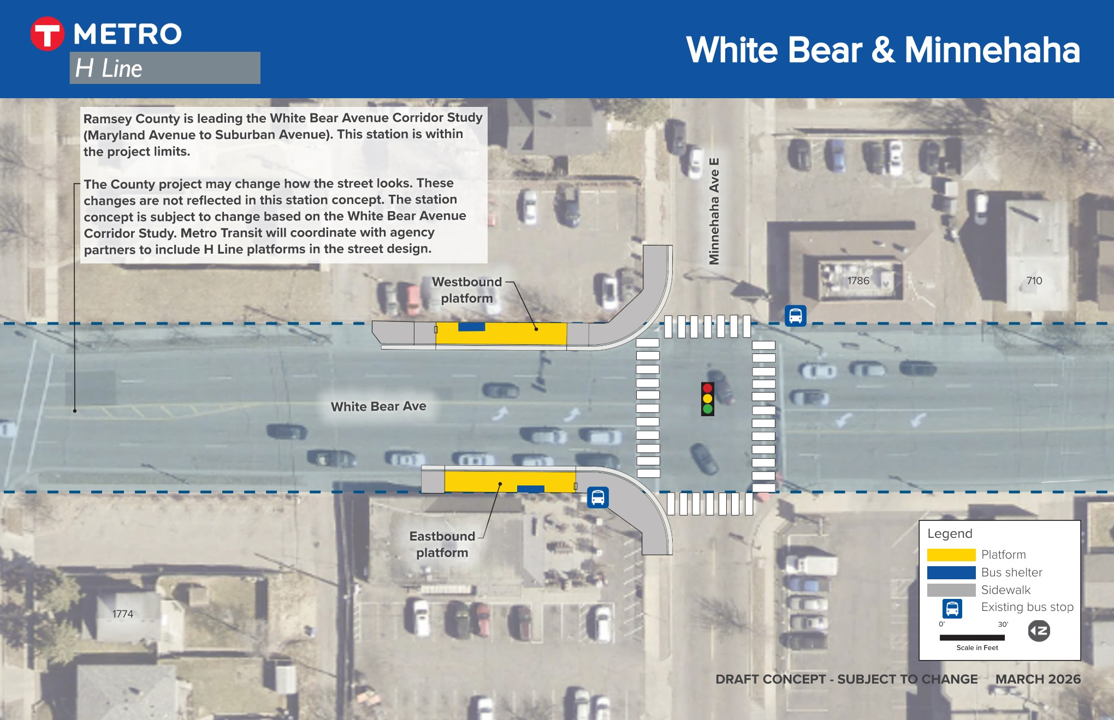
Little Oven
The Cherry Pit
Big Steer Meats
Does not reflect potential outcomes of the separate White Bear Ave Planning Study led by Ramsey Co (beginning spring 2026)
North

Slide 16
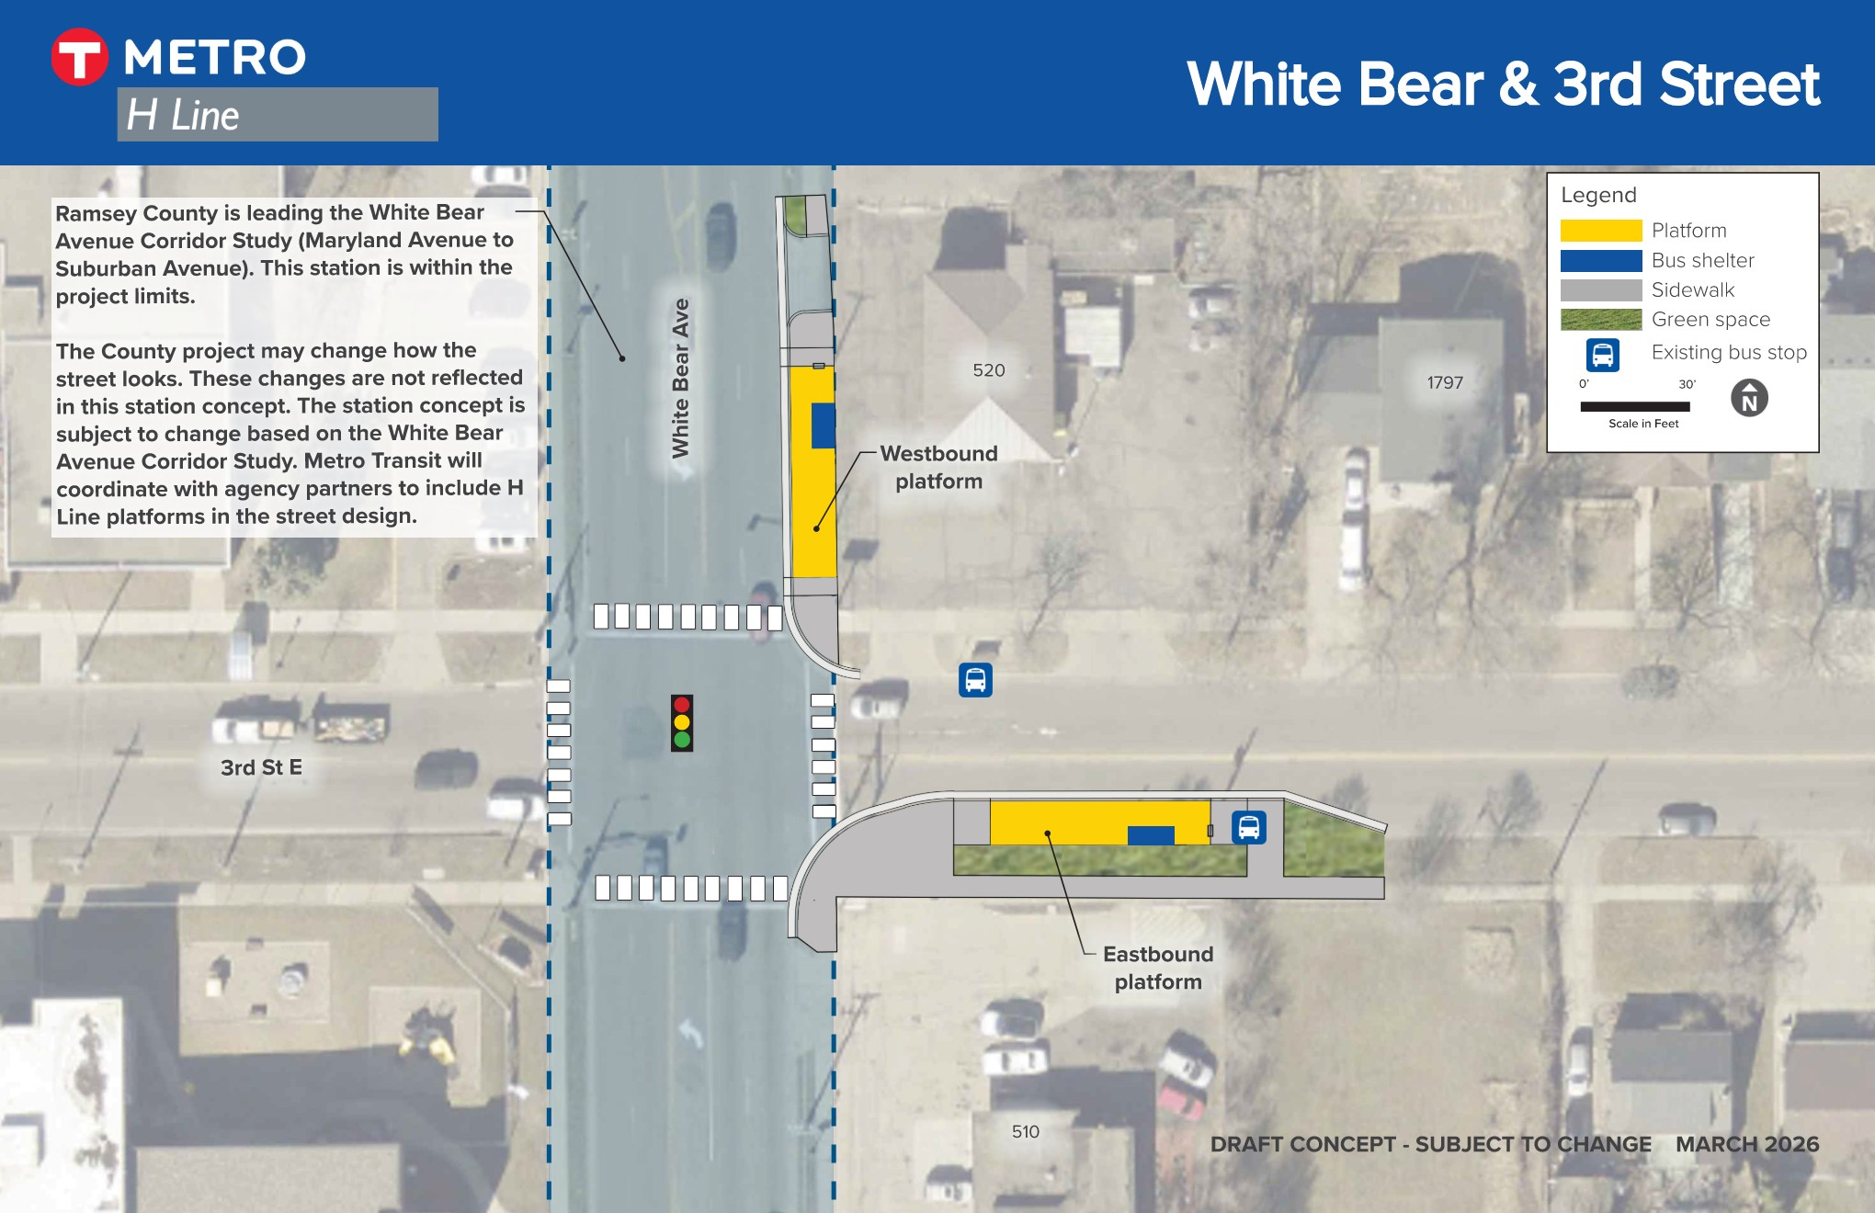
1TOU3 PHO
Does not reflect potential outcomes of the separate White Bear Ave Planning Study led by Ramsey Co (beginning spring 2026)
Mike’s Auto Repair

Slide 17
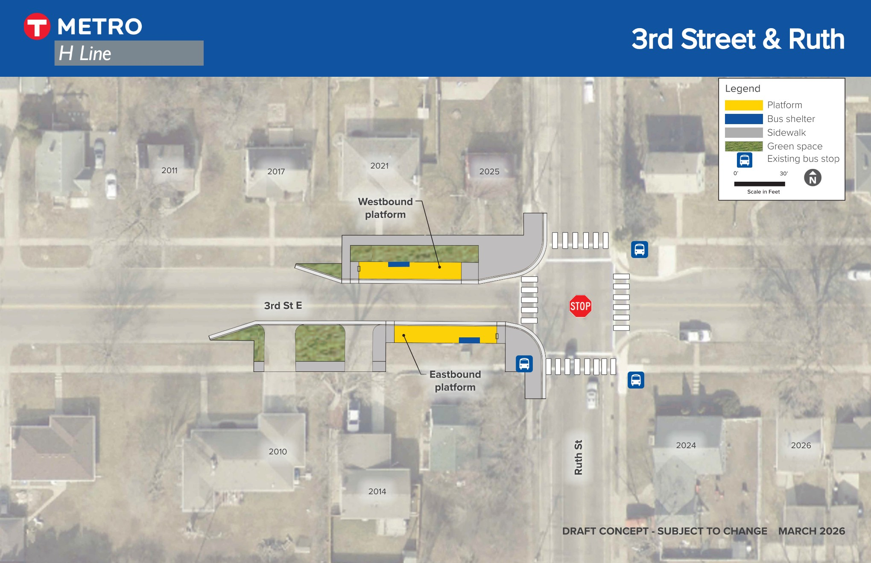

Slide 18
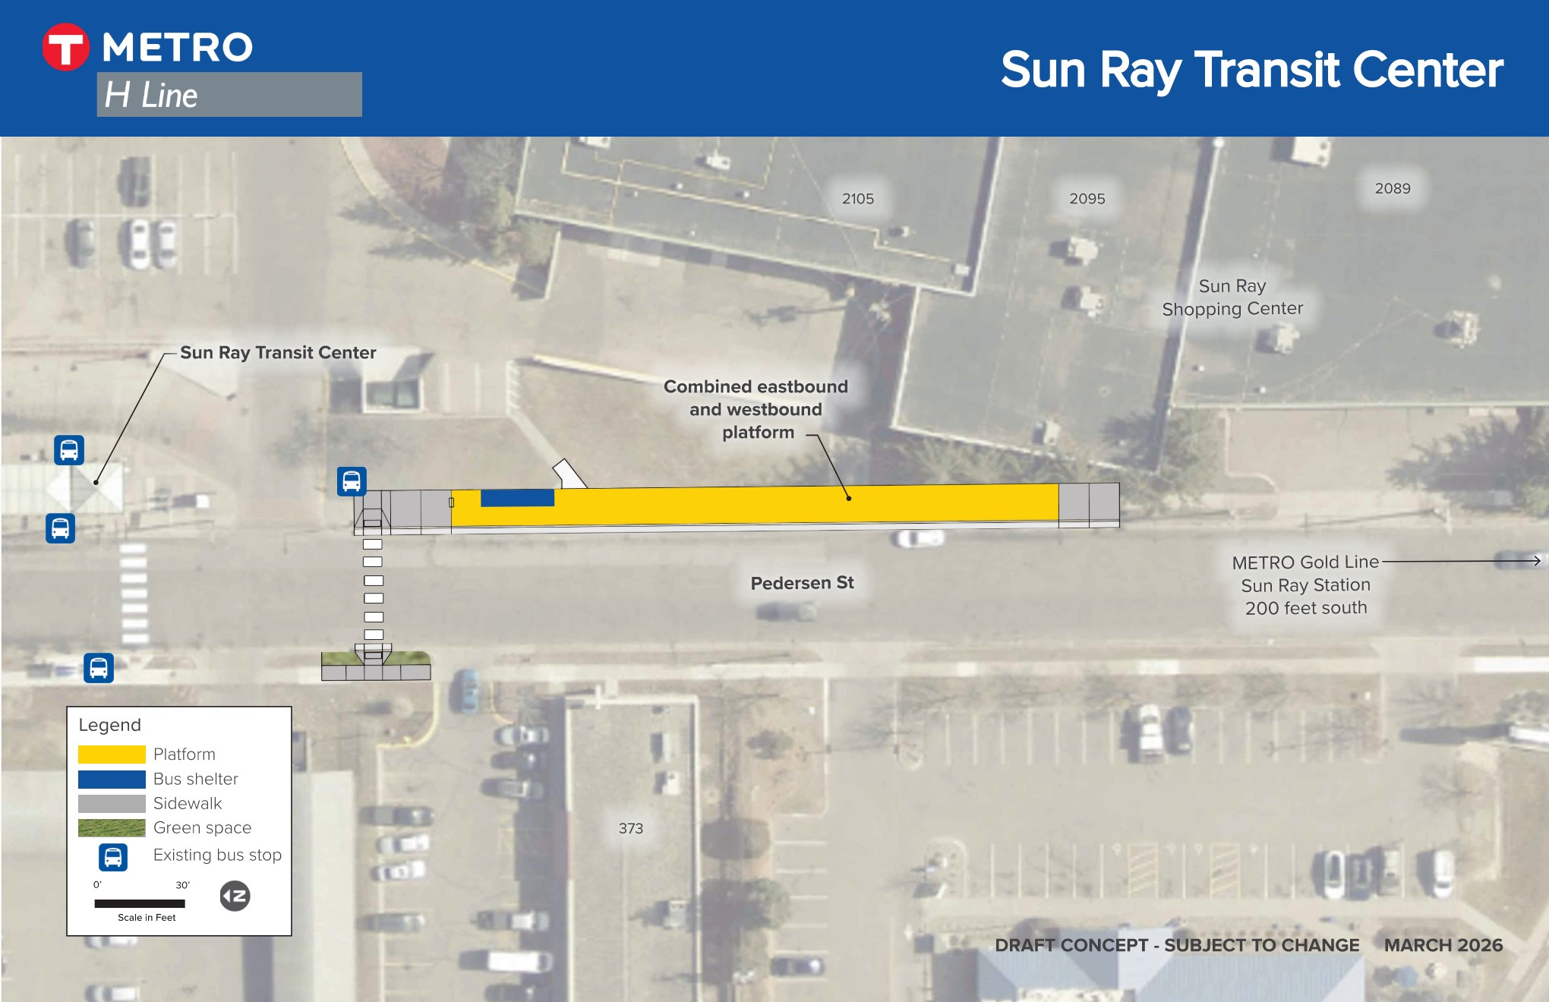
North

Slide 19

Help us plan H Line station locations
metrotransit.org/h-line-project
Review the Draft Corridor Plan and share your feedback
  Complete our survey
  HLine@metrotransit.org
Comment by May 4
Sign up for the H Line Update newsletter

Slide 20
Public engagement strategies
Survey: online and in person
Postcards mailed to all homes, businesses, and property owners along the corridor
Supplemental letter mailed to neighbors nearest stations
Targeted door knocking of neighbors nearest stations
Lawn signs, posting flyers in community
Advertising on private benches at bus stops
Email newsletters, project webpage, social media, Rider Alerts (digital & printed)
Coordinated project engagement
Partner with neighborhood, community, student, and other groups
Community events and meetings
Pop-up events at libraries, community centers, grocery stores, and other gathering locations
Engage bus riders onboard, at existing stops and transit centers
Translation of documents: English, Spanish, Somali, Oromo, Hmong, Vietnamese, Karen

Slide 21
Coordinated project: White Bear Ave Planning Study
Ramsey County-led project
From Maryland Ave to Suburban Ave
Purpose: Develop a community-driven vision for White Bear Avenue that improves safety for people walking, biking, driving, and taking transit
Coordinating with H Line and Bronze Line investments
Engagement beginning spring 2026
ramseycountymn.gov/residents/roads-transportation/current-road-projects/white-bear-avenue-corridor-study

