Slide 1

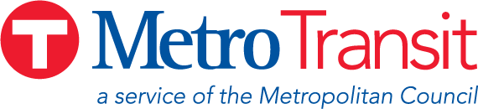
METRO H Line
Downtown Minneapolis Neighborhood Association
January 6, 2026
Alyssia (Sia) Bell | Community Outreach Coordinator

Slide 2
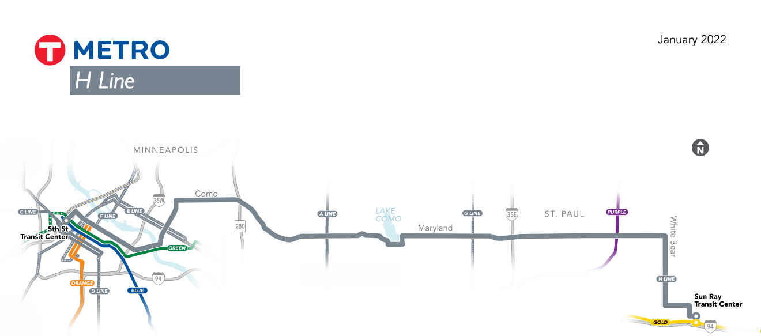
METRO H Line Bus Rapid Transit (BRT)
Bus rapid transit (BRT)
  Fast, frequent, all-day service
  Stations and buses that are comfortable, easy to use
17-mile BRT line
  Downtown Minneapolis to the East Side of Saint Paul
Substantial upgrade and extension of Route 3
  Region’s 5th highest ridership bus route in 2024

Slide 3
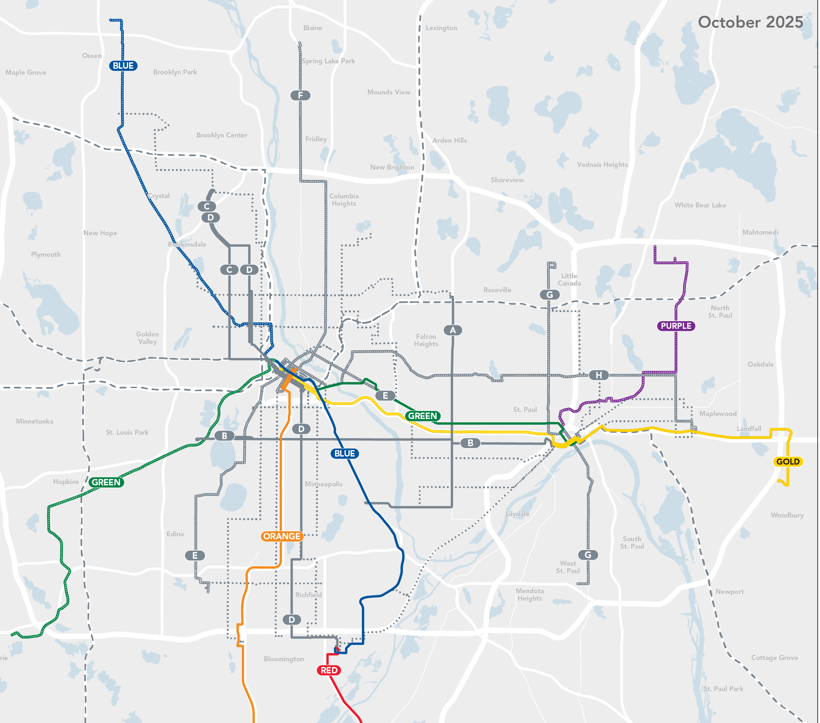
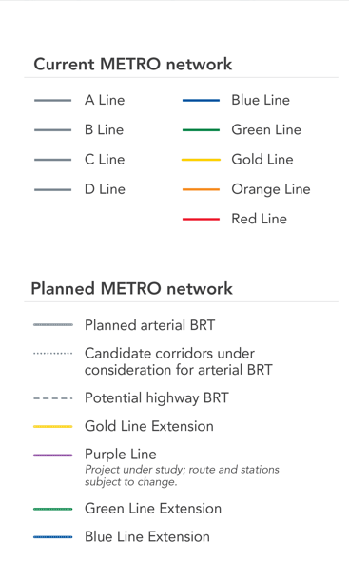
Eight planned lines by 2030
F
A Line (Snelling): 2016
B Line (Lake/Marshall): June 14, 2025
C Line (Penn): 2019
D Line (Chicago/Fremont): 2022
E Line (Hennepin/France): Construction; Dec. 6, 2025
F Line (Central): Engineering
G Line (Rice/Robert): Planning
H Line (Como/Maryland): Planning
C
A
H
B
E
G
D
Notes:
8 lines planned to be open by 2030
A Line – D Line are currently in operation
E Line opens in this Saturday! Celebration at Minneapolis College 12-2PM
F Line, G Line, and H Line are in various stages of project development
Connecting with downtown Minneapolis, the University of Minnesota, State Fairgrounds, and several other existing and planned METRO lines

Slide 4
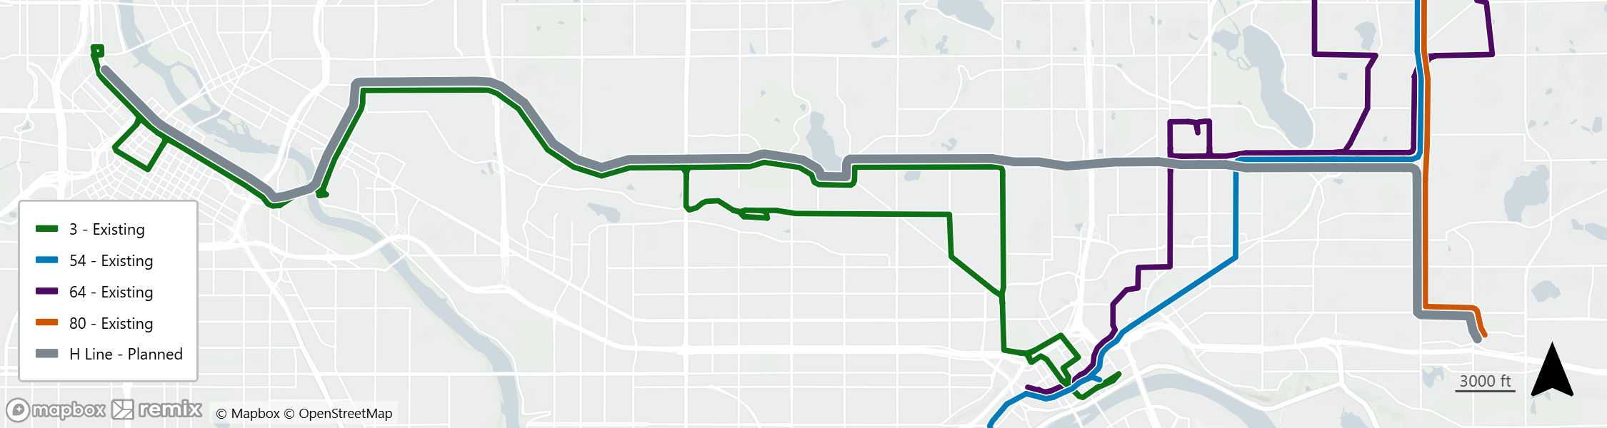
Existing bus routes in the H Line corridor
Lake Phalen Regional Park
Como Regional Park
No existing east-west service
UofM Saint Paul Campus
Como Ave
Washington Ave
15th Ave
Maryland Ave
Front Ave
White Bear Ave
UofM Minneapolis Campus
State Fairgrounds
Rice St
Como Park Sr. High
Future G Line on Rice St connecting to downtown
Sun Ray
H Line will upgrade and extend Route 3A along Como/Maryland
Alternatives will be available for portions of existing Route 3 not covered by H Line, including on Rice St (G Line) and on Energy Park Dr/Front Ave (3B)

Slide 5
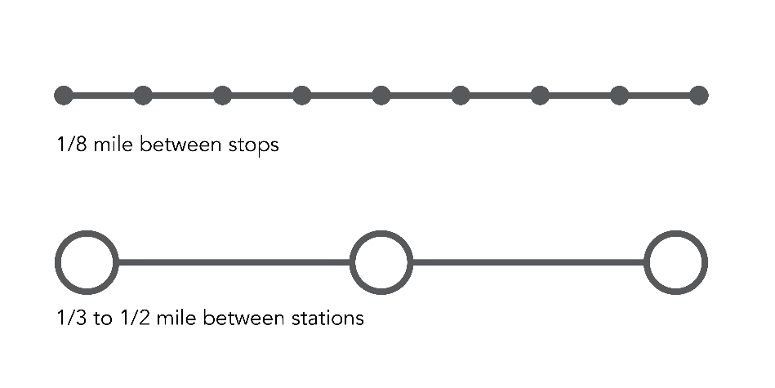
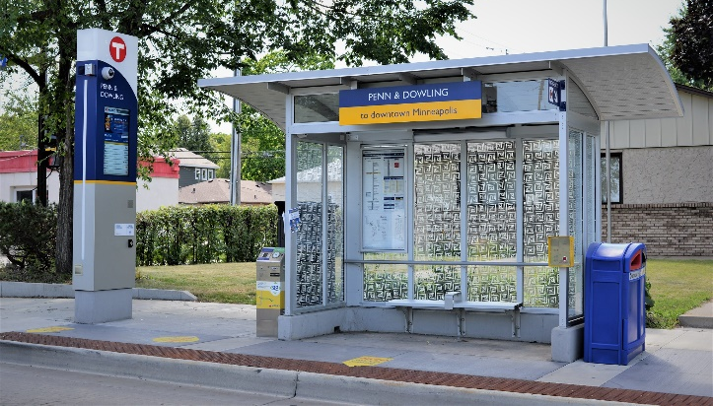
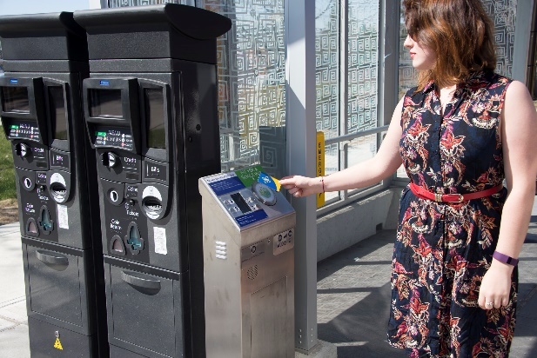
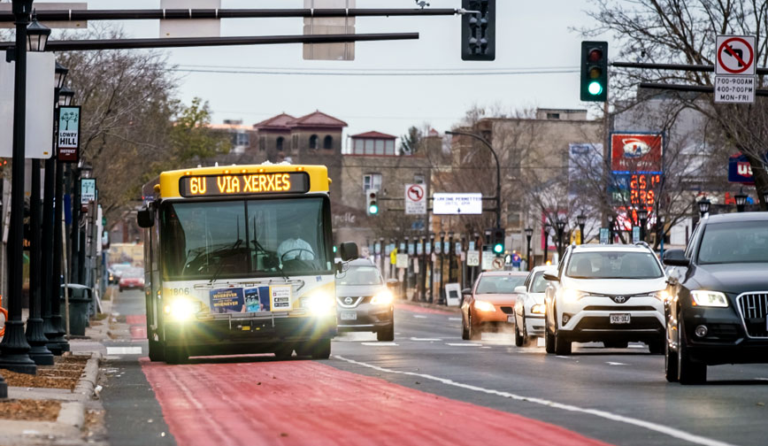
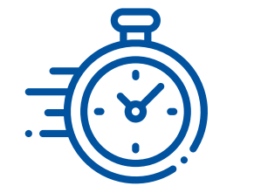
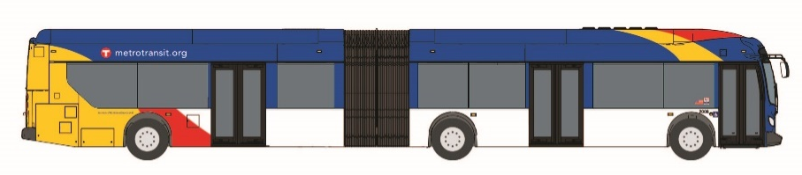
Arterial BRT:
Designed to be faster, more reliable, and easy to use
metrotransit.org/brt
2-3 stations per mile for faster trips
High-tech, high-amenity, secure stations
Pre-boarding fare payment for faster stops
Higher-capacity buses & boarding through all doors
Bus priority signals & lanes
Faster, frequent, all-day service

Slide 6
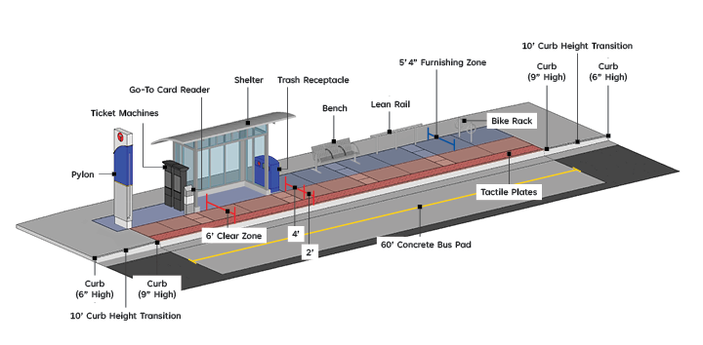
Standard arterial BRT platform design
Notes:
This slide shows the layout of a standard AbRT platform.
Standard platforms are 60 feet in length and 11.5 feet wide.
Standard platforms have a 9 inch curb.

Slide 7
Project schedule
H Line identified: March 2021
Early project coordination: 2024-2025
Draft Corridor Plan: Comment period
Winter 2026
Recommended Corridor Plan: Comment period
Summer 2026
Final Corridor Plan approved: Fall 2026
Engineering: 2026-2028
Construction: 2028 – 2029
Planning phase
Looking for community input to select station locations
Community engagement
Project schedule subject to change

Slide 8
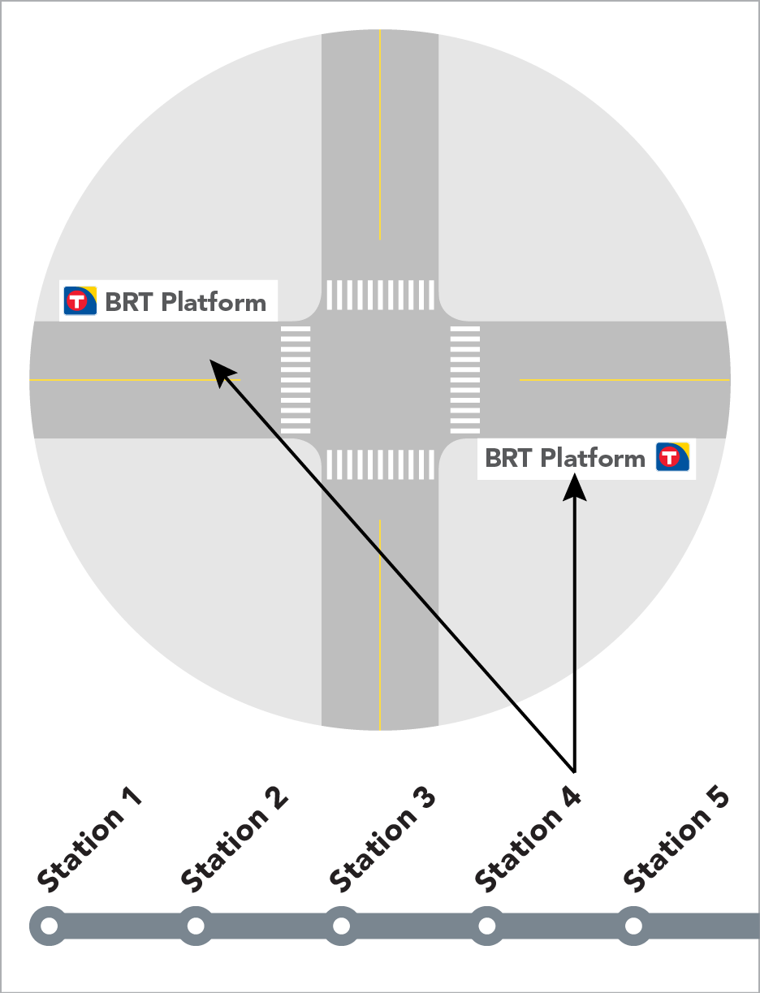
What is included in the Corridor Plan?
By the end of 2026
  Proposed station locations
  Proposed platform locations within the station intersection
  Information about how and why proposed locations were determined
Station and platform designs will be finalized during engineering phase (2027-2028)

Slide 9
When will we be seeking input during this phase?
Two public comment periods
  Winter 2026 (late February-early April), Draft Corridor Plan
  Summer 2026 (July-August), Recommended Corridor Plan
Subject to change
Draft Corridor Plan release: Late Feb. 2026
Recommended Corridor Plan release:
July 2026
Final Corridor Plan approved:
Fall 2026
Public comment period #1: Late Feb. to early April 2026
Revise Draft Corridor Plan based on input
Public comment period #2: July-August 2026
Revise Recommended Corridor Plan based on input

Slide 10
Outreach Materials
H Line corridor map
METRO Network map
One Pagers
Videos
Mailers
Flyers
Presentations
Newsletters
Email Campaigns
Project Website
Rider Alerts

Slide 11
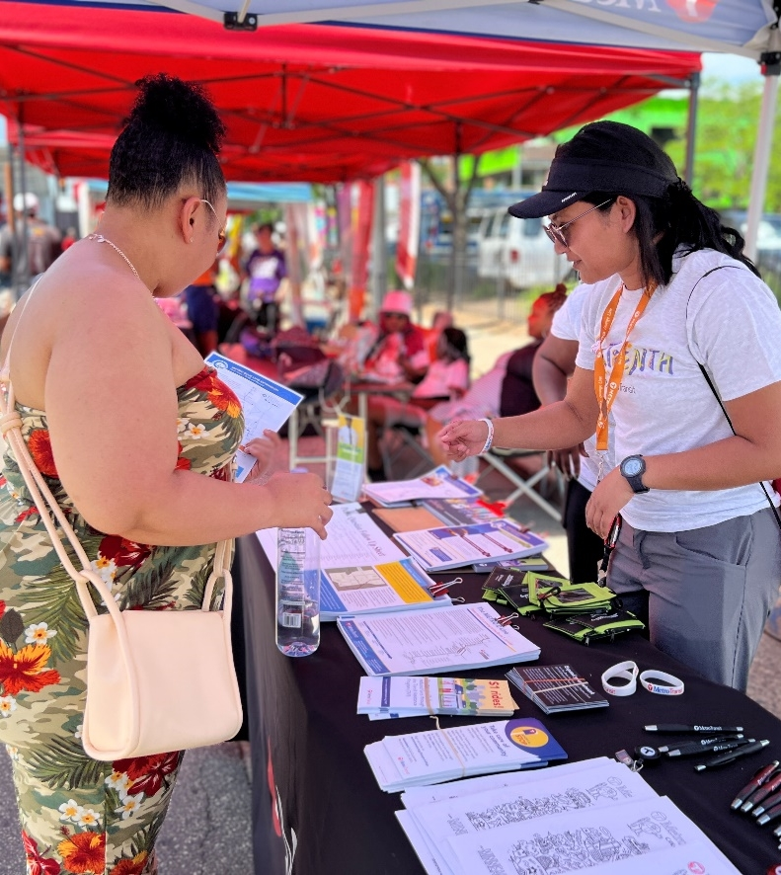
How will we engage?
Direct mailing to all homes, businesses, and property owners along the corridor
Door knocking with station-specific flyers
Pop-up events
Distribute messages through local elected officials, cities, and partner agencies
Partner with neighborhood, community, business, and advocacy groups
Existing route bus rider outreach
Email newsletters, project webpage, social media
Translation of documents
Participate in community events and meetings
Collect feedback via online and in-person surveys

Slide 12
Thank You!
Alyssia Bell
hline@metrotransit.org

