Slide 1
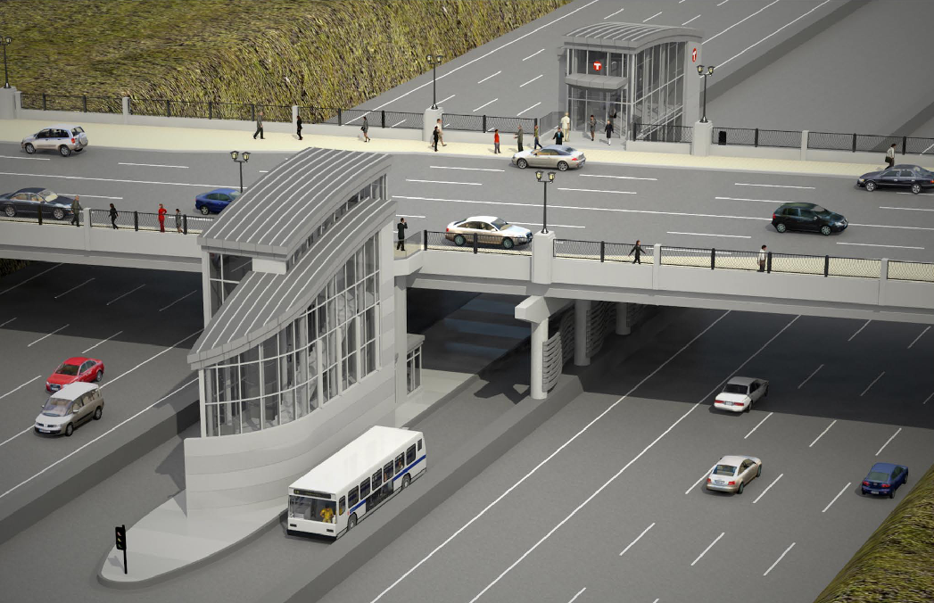
I-35W and 46th Street
Final Service Restructuring Plan

Slide 2
I-35W and 46th St. Station Plan
Station a key element of I-35W Bus Rapid Transit (BRT).
Facilitates reliable, comfortable and convenient
transfers between I-35W and cross-town bus lines.
Provides access to:
  South suburban locations (reverse-commute)
  Downtown Minneapolis, connecting service
  The University of Minnesota
Implemented within existing operating resources

Slide 3
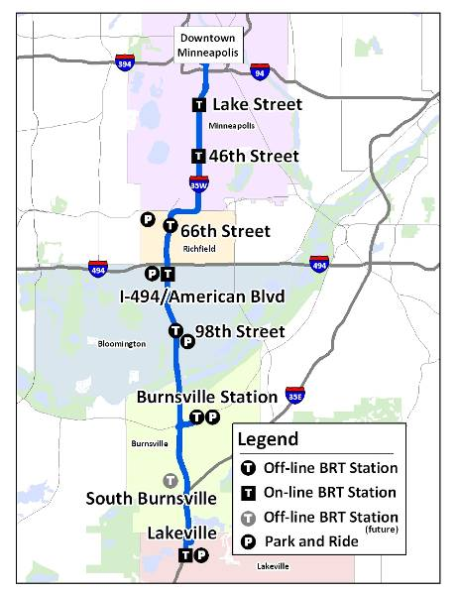
Planning for future Bus Rapid Transit (BRT)
Higher Frequencies
  Station-Station
  Express
More destinations
  Local connections
Flexible and efficient
35W BRT introduction 2012

Slide 4
Public Input: May-July, 2010
Concept Plan & Public Input Distribution
  Press release
  Website
  Email to neighborhoods
  Brochures and announcements on buses
  Bus stop postings
Public Hearing
  Three Metro Transit meetings, 43 attendees
  Numerous neighborhood organizations
  131 Public comments
Plan Modifications
Notes:
Three Metro Transit –sponsored meetings were the Informational Meeting in Richfield-Woodlake Nature Center, June 2 at 5:00 pm, the Informational Meeting in Minneapolis-Fuller Park, June 15 at 5:00 pm, and the Public Hearing at the Minneapolis Central Library June 29th at 11:30.

Slide 5
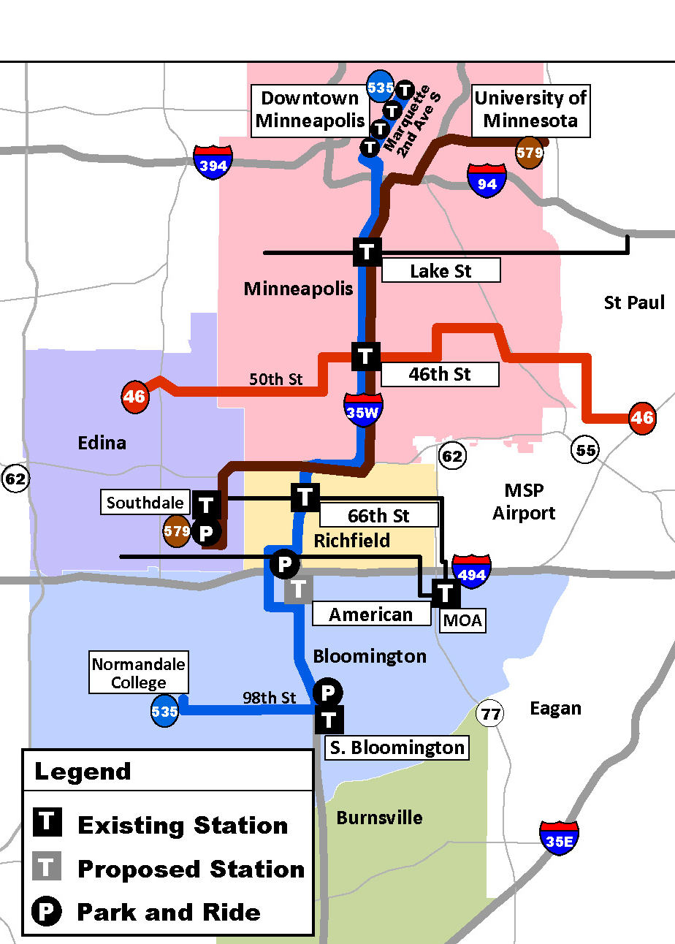
Final Plan Core Objectives
  Frequent Route 535 service on I-35W
    Station to Station
    Improved rush hour service
    Uses new MNPASS HOT Lanes
  All day cross town service
    Route 46 rush hour service improved
  I-35W & 46th Street Connection
    All day access on weekdays
    Direct Connection to U of M
  Preview of BRT Service Plan Concepts

Slide 6
Final Plan Changes based on public input
Route 135
  No extension to 50th St., keep terminal at 48th & Grand Ave. Reduce AM service by one trip and re-time to serve downtown work starts better.
Route 146
  Maintain service at slightly reduced level. Extend three AM and PM trips via Vernon Ave. to Lincoln Dr.
Route 579
  Improve service during U of M breaks, replaces Route 152 with connections at station.
Notes:
Route 579 also offers a longer span of service than Route 152 does today during main school year. One hour later in AM and in PM.

Slide 7
Next Steps
August - Final Plan approval
August/September – Schedule development
October-December – communication/coordination
December 4, 2010 Implementation

Slide 8
